Slide 1
TOEFL Reading Enhancement
上海新东方国际教育培训中心
黄一鸣

Slide 2
课程内容
各种介绍（自我介绍，考试介绍，课堂介绍）
事实信息题
否定事实信息题

Slide 3
托福阅读考试基本形式
文章长度 | 题量 | 时间
？字/篇 | ？篇 | 共？min
 | ？题/篇

Slide 4
托福阅读考试基本形式
文章长度 | 题量 | 时间
约700字/篇 | 3-4篇 | 共60-80min
 | 12-14题/篇

Slide 5
托福阅读考试基本形式
文章长度 | 题量 | 时间
约700字/篇 | 3-4篇 | 共54-72min
 | 9-10题/篇

Slide 6
快速出分
考试时间缩短：3.5h ➡️ 3h
两场托福考试的报名间隔时间：12天缩减为3天。
考试结束后6天可在线查看分数
阅读听力当场出分（unofficial score)

Slide 7
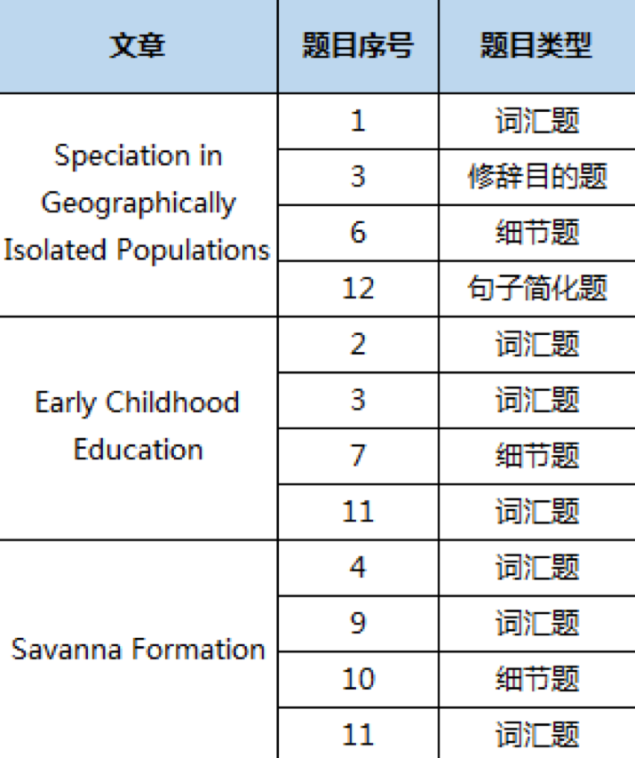

2019.8.1改革
时间变短
题量变少
难度“好像”增加

Slide 8
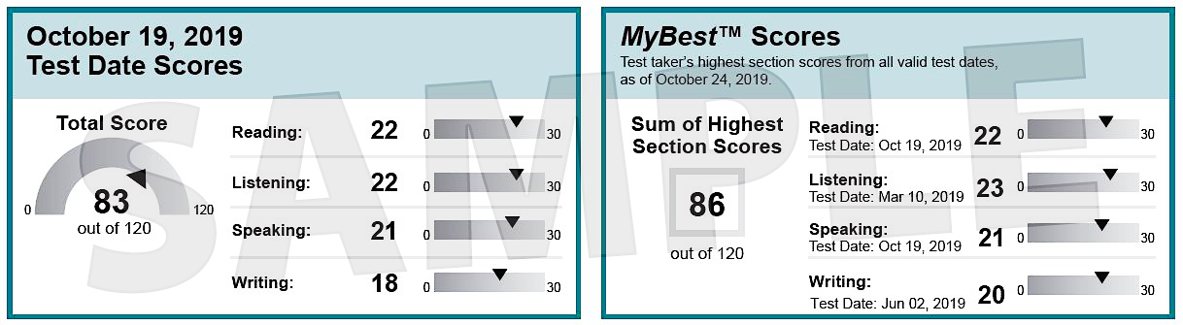
MyBest Scores
有效成绩的最高分组合
大部分高校接受

Slide 9
托福分数分布：80雨露均沾
总分 | 阅读 | 听力 | 口语 | 写作
60 | 14 | 13 | 17 | 16
80 | 21 | 19 | 20 | 20
100 | 27 | 26 | 23 | 25
105 | 29 | 27 | 23 | 26
110 | 30 | 29 | 25 | 27
115 | 30 | 30 | 28 | 28

Slide 10
托福分数分布：100阅写是基础
总分 | 阅读 | 听力 | 口语 | 写作
60 | 14 | 13 | 17 | 16
80 | 21 | 19 | 20 | 20
100 | 27 | 26 | 23 | 25
105 | 29 | 27 | 23 | 26
110 | 30 | 29 | 25 | 27
115 | 30 | 30 | 28 | 28

Slide 11
Scoring Scale (OG 6th)
Raw Point Total | Scaled Score
32-33 | 30
31 | 29-30
30 | 28-30
29 | 27-28
28 | 26-29
27 | 25-28
26 | 24-27
25 | 23-26
24 | 21-25
23 | 20-25
Raw Point Total | Scaled Score
22 | 19-24
21 | 18-23
20 | 17-22
19 | 15-21
18 | 14-20
17 | 13-19
16 | 11-18
15 | 10-17
14 | 8-16
13 | 7-15

Slide 12
Scoring Scale (OG 6th)
Raw Point Total | Scaled Score
32-33 | 30
31 | 29-30
30 | 28-30
29 | 27-28
28 | 26-29
27 | 25-28
26 | 24-27
25 | 23-26
24 | 21-25
23 | 20-25
Raw Point Total | Scaled Score
22 | 19-24
21 | 18-23
20 | 17-22
19 | 15-21
18 | 14-20
17 | 13-19
16 | 11-18
15 | 10-17
14 | 8-16
13 | 7-15

Slide 13
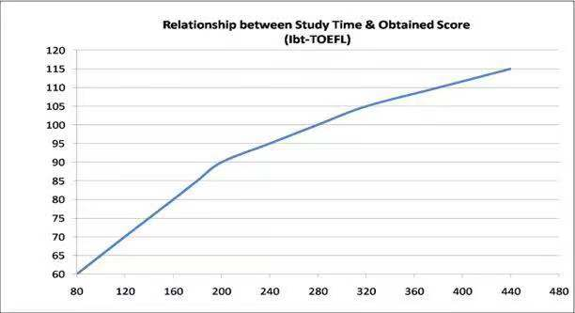
托福考试ETS官方建议学习小时数
想要100+，需要至少进行280小时的课程学习与课后练习。
Notes:
128

Slide 14
托福阅读题型
1 | 词汇题
2 | 指代题
3 | 事实信息题
4 | 句子简化题
5 | 否定事实信息题
6 | 推断题
7 | 插入句子题
8 | 修辞目的题
9 | 总结题
10 | 表格题

Slide 15
托福阅读题型
1 | 词汇题
2 | 指代题
3 | 事实信息题
4 | 句子简化题
5 | 否定事实信息题
6 | 推断题
7 | 插入句子题
8 | 修辞目的题
9 | 总结题
10 | 表格题

Slide 16
强化班课程大纲
1 | 考试介绍，事实信息题
2 | 否定事实信息题
3 | 句子简化题
4 | 句子插入题
5 | 修辞目的题
6 | 推断题
7 | 总结题
8 | 复习，篇章练习

Slide 17

课堂要求
1. 笔记
解题方法思路
单词单词单词
2. TPO练习
3. 背单词
方法论：
1 考察内容，题量，难易度
2 方法
step 123
…
exploit
v. 剥削，利用
=utilize

Slide 18
怎么背：
背什么：
1. 分散时间，零散时间重复记忆
2. 固定数量：每天循环2-3个list
3. 推荐语境：
- 英文操作系统
- BBC/discovery纪录片
- 英文歌
专业词汇❌
花鸟鱼虫的名字
学科概念
常用词汇✅
动词
形容词
逻辑关系词

Slide 19
事实信息题
Factual Information Question

Slide 20
题型识别
According to the paragraph, which of the following is true of X?
The author’s description of X mentions which of the following?
According to the paragraph, why did X do Y?
According to the paragraph, X occurred because…
According to the paragraph, X did Y because…

Slide 21
题型识别
1. 题目数量（2-5/篇）
2. 考察：识别文章明确说明的信息（通常1-2句话是问题的答案）
3. 难度：2-3/5

Slide 22
题型识别
✌️定位！！！！！
According to the paragraph, which of the following is true of X?
The author’s description of X mentions which of the following?
According to the paragraph, why did X do Y?
According to the paragraph, X occurred because…
According to the paragraph, X did Y because…

Slide 23
题型分类
According to the paragraph, which of the following is true?
According to the paragraph, why did X do Y?
1.可定位
2.不可定位

Slide 24
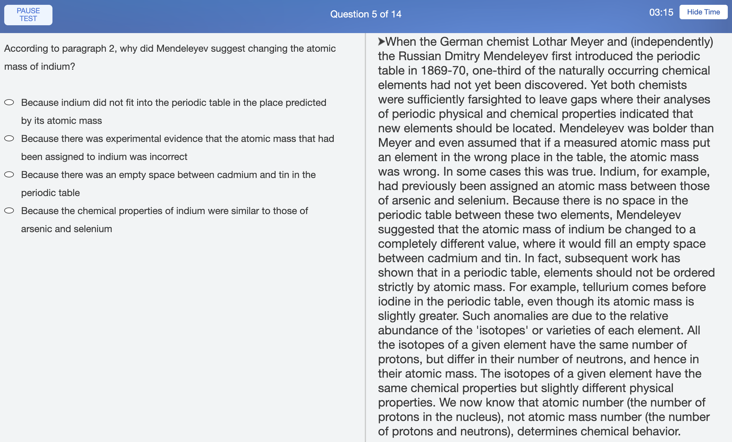
可 定 位
2
1
3

Slide 25
可 定 位
According to paragraph 2, why did Mendeleyev suggest changing the atomic mass of indium?

Slide 26
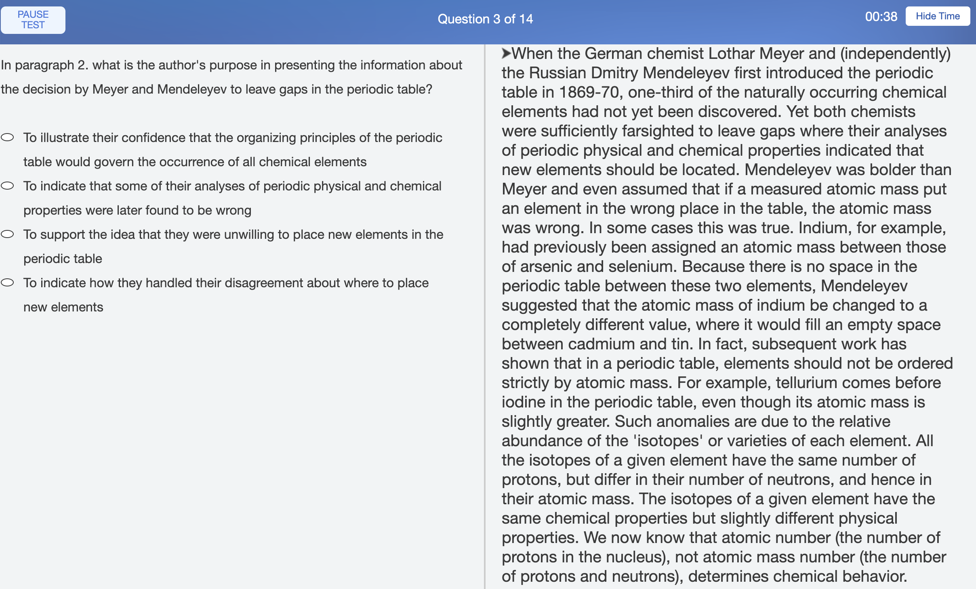
可 定 位
3/14

Slide 27
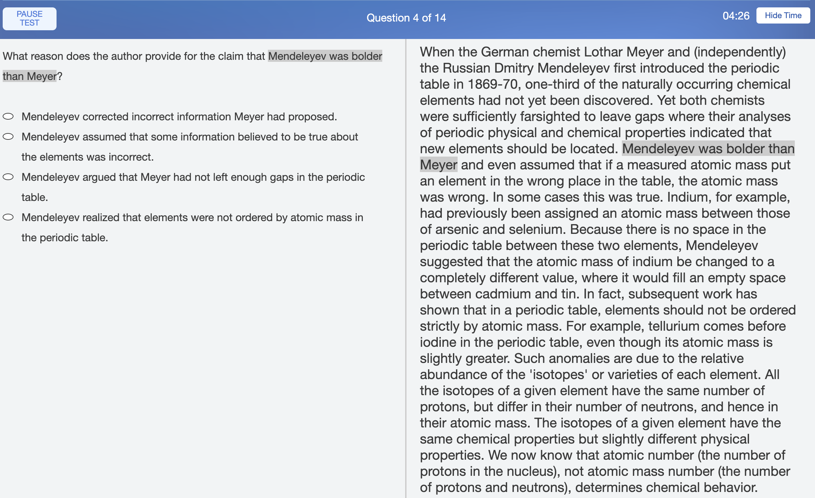
可 定 位
4/14

Slide 28
可 定 位
5/14

Slide 29
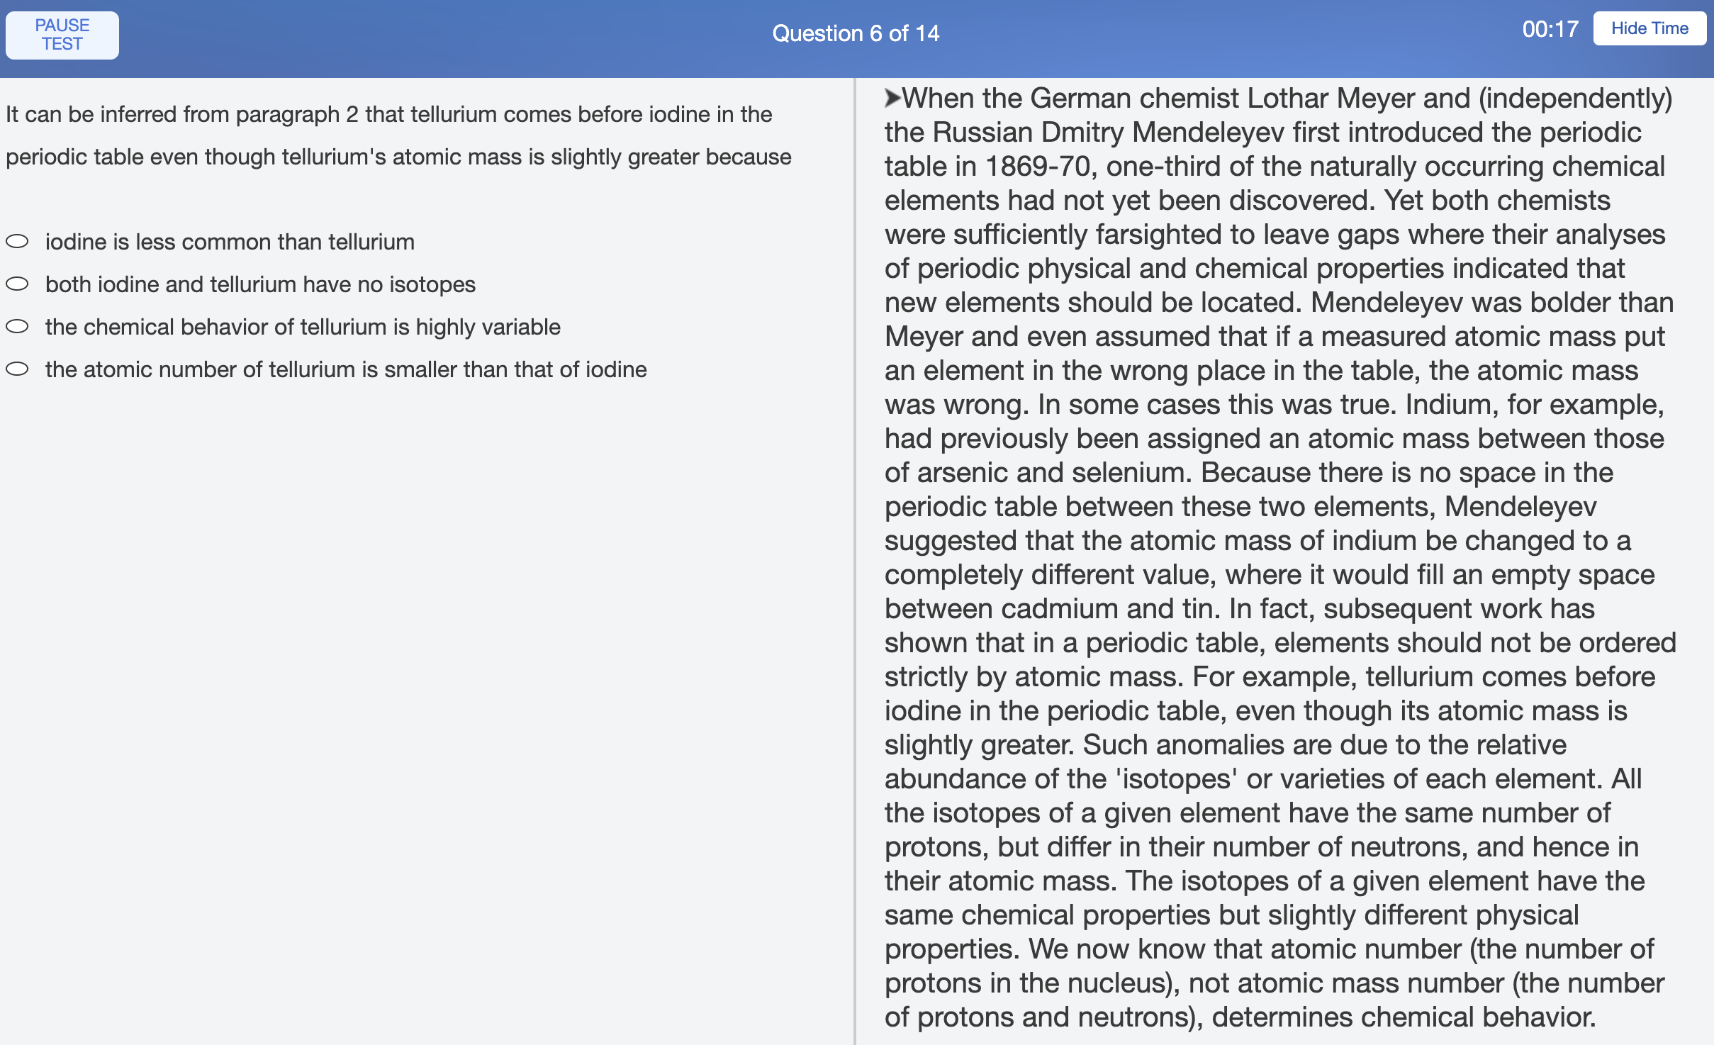
可 定 位
6/14

Slide 30
可定位
Step 1：大定位（从上一题定位句之后开始读）

Slide 31
可定位
Step 1：大定位（从上一题定位句之后开始读）
Step 2：小定位（找1-2句话）

Slide 32
皮卡丘是一只矮矮胖胖圆乎乎的类啮齿型宝可梦，全身的皮毛都是黄色的。它的耳朵很长，尖端是黑色的。皮卡丘有小小的嘴巴，侧面看起来像一个数字 3。这种宝可梦的脸颊上有两个红色的圆，那是它的电力袋，遇到危险时就会放电，尾巴是像锯齿状的闪电。Pikachu会将尾巴竖起来，去感觉周围是否安全。尽管它确切来说是四足动物，更多时候它是站着并用两只后脚走路。住在森林中的它们通常以树果为食，皮卡丘们用小小的电击把树果从树上打下来，这样就不必爬树，还可以顺带将其烤熟。
1. 皮卡丘身上的哪个部位像 3？
A. 尾巴
B. 嘴巴

Slide 33
皮卡丘是一只矮矮胖胖圆乎乎的类啮齿型宝可梦，全身的皮毛都是黄色的。它的耳朵很长，尖端是黑色的。皮卡丘有小小的嘴巴，侧面看起来像一个数字 3。这种宝可梦的脸颊上有两个红色的圆，那是它的电力袋，遇到危险时就会放电，尾巴是像锯齿状的闪电。Pikachu会将尾巴竖起来，去感觉周围是否安全。尽管它确切来说是四足动物，更多时候它是站着并用两只后脚走路。住在森林中的它们通常以树果为食，皮卡丘们用小小的电击把树果从树上打下来，这样就不必爬树，还可以顺带将其烤熟。
1. 皮卡丘身上的哪个部位像 3？
A. 尾巴
B. 嘴巴

Slide 34
皮卡丘是一只矮矮胖胖圆乎乎的类啮齿型宝可梦，全身的皮毛都是黄色的。它的耳朵很长，尖端是黑色的。皮卡丘有小小的嘴巴，侧面看起来像一个数字 3。这种宝可梦的脸颊上有两个红色的圆，那是它的电力袋，遇到危险时就会放电，尾巴是像锯齿状的闪电。Pikachu会将尾巴竖起来，去感觉周围是否安全。尽管它确切来说是四足动物，更多时候它是站着并用两只后脚走路。住在森林中的它们通常以树果为食，皮卡丘们用小小的电击把树果从树上打下来，这样就不必爬树，还可以顺带将其烤熟。
1. 皮卡丘身上的哪个部位像 3？
A. 尾巴
B. 嘴巴

Slide 35
可定位
Step 2：小定位（找1-2句话）
定位词：
1 |  | American, NREM
2 |  | 1815, 80° to 180°
3 |  | Spartina, photosynthetic, neurotransmitter

Slide 36
可定位
Step 2：小定位（找1-2句话）
定位词：
1 | 大写字母 | American, NREM
2 | 数字时间 | 1815, 80° to 180°
3 | 特殊名词、学科概念 | Spartina, photosynthetic, neurotransmitter

Slide 37
Paragraph 3: The West had plenty of attractions: the alluvial river bottoms, the fecund soils of the rolling forest lands, the black loams of the prairies were tempting to New England farmers working their rocky, sterile land and to southeastern farmers plagued with soil depletion and erosion. In 1820 under a new land law, a farm could be bought for $100. The continued proliferation of banks made it easier for those without cash to negotiate loans in paper money. Western Farmers borrowed with the confident expectation that the expanding economy would keep farm prices high, thus making it easy to repay loans when they fell due.
20-1-6. According to paragraph 3, what was the significance of the land law passed in 1820?
It granted government-supported loans to farmers.
It provided farmland at an affordable price.
It required banks to offer loans to farmers.
It enabled farmers to sell their land for a profit.

Slide 38
Paragraph 3: The West had plenty of attractions: the alluvial river bottoms, the fecund soils of the rolling forest lands, the black loams of the prairies were tempting to New England farmers working their rocky, sterile land and to southeastern farmers plagued with soil depletion and erosion. In 1820 under a new land law, a farm could be bought for $100. The continued proliferation of banks made it easier for those without cash to negotiate loans in paper money. Western Farmers borrowed with the confident expectation that the expanding economy would keep farm prices high, thus making it easy to repay loans when they fell due.
20-1-6. According to paragraph 3, what was the significance of the land law passed in 1820?
It granted government-supported loans to farmers.
It provided farmland at an affordable price.
It required banks to offer loans to farmers.
It enabled farmers to sell their land for a profit.

Slide 39
Paragraph 3: The West had plenty of attractions: the alluvial river bottoms, the fecund soils of the rolling forest lands, the black loams of the prairies were tempting to New England farmers working their rocky, sterile land and to southeastern farmers plagued with soil depletion and erosion. In 1820 under a new land law, a farm could be bought for $100. The continued proliferation of banks made it easier for those without cash to negotiate loans in paper money. Western Farmers borrowed with the confident expectation that the expanding economy would keep farm prices high, thus making it easy to repay loans when they fell due.
20-1-6. According to paragraph 3, what was the significance of the land law passed in 1820?
It granted government-supported loans to farmers.
It provided farmland at an affordable price.
It required banks to offer loans to farmers.
It enabled farmers to sell their land for a profit.

Slide 40
Paragraph 3: The West had plenty of attractions: the alluvial river bottoms, the fecund soils of the rolling forest lands, the black loams of the prairies were tempting to New England farmers working their rocky, sterile land and to southeastern farmers plagued with soil depletion and erosion. In 1820 under a new land law, a farm could be bought for $100. The continued proliferation of banks made it easier for those without cash to negotiate loans in paper money. Western Farmers borrowed with the confident expectation that the expanding economy would keep farm prices high, thus making it easy to repay loans when they fell due.
20-1-6. According to paragraph 3, what was the significance of the land law passed in 1820?
It granted government-supported loans to farmers.
It provided farmland at an affordable price.
It required banks to offer loans to farmers.
It enabled farmers to sell their land for a profit.

Slide 41
Paragraph 3: The West had plenty of attractions: the alluvial river bottoms, the fecund soils of the rolling forest lands, the black loams of the prairies were tempting to New England farmers working their rocky, sterile land and to southeastern farmers plagued with soil depletion and erosion. In 1820 under a new land law, a farm could be bought for $100. The continued proliferation of banks made it easier for those without cash to negotiate loans in paper money. Western Farmers borrowed with the confident expectation that the expanding economy would keep farm prices high, thus making it easy to repay loans when they fell due.
20-1-6. According to paragraph 3, what was the significance of the land law passed in 1820?
It granted government-supported loans to farmers.
It provided farmland at an affordable price.
It required banks to offer loans to farmers.
It enabled farmers to sell their land for a profit.

Slide 42
Paragraph 2: By far the most abundant form of geothermal energy occurs at the relatively low temperatures of 80° to 180° centigrade. Water circulated through heat reservoirs in this temperature range is able to extract enough heat to warm residential, commercial, and industrial spaces. More than 20,000 apartments in France are now heated by warm underground water drawn from a heat reservoir in a geologic structure near Paris called the Paris Basin. Iceland sits on a volcanic structure known as the Mid-Atlantic Ridge. Reykjavik, the capital of Iceland, is entirely heated by geothermal energy derived from volcanic heat.
21-1-4. According to paragraph 2, which of the following is true about heat reservoirs with a temperature in the range of 80° to 180° centigrade?
They are under international control.
They are more common than reservoirs that have a higher temperature.
Few of them produce enough heat to warm large industrial spaces.
They are used to generate electricity.

Slide 43
Paragraph 2: By far the most abundant form of geothermal energy occurs at the relatively low temperatures of 80° to 180° centigrade. Water circulated through heat reservoirs in this temperature range is able to extract enough heat to warm residential, commercial, and industrial spaces. More than 20,000 apartments in France are now heated by warm underground water drawn from a heat reservoir in a geologic structure near Paris called the Paris Basin. Iceland sits on a volcanic structure known as the Mid-Atlantic Ridge. Reykjavik, the capital of Iceland, is entirely heated by geothermal energy derived from volcanic heat.
21-1-4. According to paragraph 2, which of the following is true about heat reservoirs with a temperature in the range of 80° to 180° centigrade?
They are under international control.
They are more common than reservoirs that have a higher temperature.
Few of them produce enough heat to warm large industrial spaces.
They are used to generate electricity.

Slide 44
Paragraph 2: By far the most abundant form of geothermal energy occurs at the relatively low temperatures of 80° to 180° centigrade. Water circulated through heat reservoirs in this temperature range is able to extract enough heat to warm residential, commercial, and industrial spaces. More than 20,000 apartments in France are now heated by warm underground water drawn from a heat reservoir in a geologic structure near Paris called the Paris Basin. Iceland sits on a volcanic structure known as the Mid-Atlantic Ridge. Reykjavik, the capital of Iceland, is entirely heated by geothermal energy derived from volcanic heat.
21-1-4. According to paragraph 2, which of the following is true about heat reservoirs with a temperature in the range of 80° to 180° centigrade?
They are under international control.
They are more common than reservoirs that have a higher temperature.
Few of them produce enough heat to warm large industrial spaces.
They are used to generate electricity.

Slide 45
Paragraph 2: By far the most abundant form of geothermal energy occurs at the relatively low temperatures of 80° to 180° centigrade. Water circulated through heat reservoirs in this temperature range is able to extract enough heat to warm residential, commercial, and industrial spaces. More than 20,000 apartments in France are now heated by warm underground water drawn from a heat reservoir in a geologic structure near Paris called the Paris Basin. Iceland sits on a volcanic structure known as the Mid-Atlantic Ridge. Reykjavik, the capital of Iceland, is entirely heated by geothermal energy derived from volcanic heat.
21-1-4. According to paragraph 2, which of the following is true about heat reservoirs with a temperature in the range of 80° to 180° centigrade?
They are under international control.
They are more common than reservoirs that have a higher temperature.
Few of them produce enough heat to warm large industrial spaces.
They are used to generate electricity.

Slide 46
23-3-7. According to paragraph 4, researchers have organized and structured Australian rock art by distinguishing between which of the following?

Slide 47
Although the remarkable antiquity of Australia’s rock art is now established, the sequences and meanings of its images have been widely debated. Since the mid-1970s, a reasonably stable picture has formed of the organization of Australian rock art. In order to create a sense of structure to this picture, researchers have relied on a distinction that still underlies the forms of much indigenous visual culture - a distinction between geometric and figurative elements. Simple geometric repeated patterns - circles, concentric circles, and lines - constitute the iconography (characteristic images) of the earliest rock-art sites found across Australia. The frequency with which certain simple motifs appear in these oldest sites has led rock-art researchers to adopt a descriptive term - the Panaramitee style - a label which takes its name from the extensive rock pavements at Panaramitee North in desert South Australia, which are covered with motifs pecked into the surface. Certain features of these engravings lead to the conclusion that they are of great age - geological changes had clearly happened after the designs had been made and local Aboriginal informants, when first questioned about them, seemed to know nothing of their origins. Furthermore, the designs were covered with “desert varnish”, a glaze that develops on rock surfaces over thousands of years of exposure to the elements. The simple motifs found at Panaramitee are common to many rock-art sites across Australia. Indeed, sites with engravings of geometric shapes are also to be found on the island of Tasmania, which was separated from the mainland of the continent some 10,000 years ago.
23-3-7. According to paragraph 4, researchers have organized and structured Australian rock art by distinguishing between which of the following?

Slide 48
Although the remarkable antiquity of Australia’s rock art is now established, the sequences and meanings of its images have been widely debated. Since the mid-1970s, a reasonably stable picture has formed of the organization of Australian rock art. In order to create a sense of structure to this picture, researchers have relied on a distinction that still underlies the forms of much indigenous visual culture - a distinction between geometric and figurative elements. Simple geometric repeated patterns - circles, concentric circles, and lines - constitute the iconography (characteristic images) of the earliest rock-art sites found across Australia. The frequency with which certain simple motifs appear in these oldest sites has led rock-art researchers to adopt a descriptive term - the Panaramitee style - a label which takes its name from the extensive rock pavements at Panaramitee North in desert South Australia, which are covered with motifs pecked into the surface. Certain features of these engravings lead to the conclusion that they are of great age - geological changes had clearly happened after the designs had been made and local Aboriginal informants, when first questioned about them, seemed to know nothing of their origins. Furthermore, the designs were covered with “desert varnish ”, a glaze that develops on rock surfaces over thousands of years of exposure to the elements. The simple motifs found at Panaramitee are common to many rock-art sites across Australia. Indeed, sites with engravings of geometric shapes are also to be found on the island of Tasmania, which was separated from the mainland of the continent some 10,000 years ago.
23-3-7. According to paragraph 4, researchers have organized and structured Australian rock art by distinguishing between which of the following?

Slide 49
可定位
Step 1：大定位（从上一题定位句之后开始读）
Step 2：小定位（找1-2句话）（不是连连看）

Slide 50
Paragraph 2: By far the most abundant form of geothermal energy occurs at the relatively low temperatures of 80° to 180° centigrade. Water circulated through heat reservoirs in this temperature range is able to extract enough heat to warm residential, commercial, and industrial spaces. More than 20,000 apartments in France are now heated by warm underground water drawn from a heat reservoir in a geologic structure near Paris called the Paris Basin. Iceland sits on a volcanic structure known as the Mid-Atlantic Ridge. Reykjavik, the capital of Iceland, is entirely heated by geothermal energy derived from volcanic heat.
21-1-4. According to paragraph 2, which of the following is true about heat reservoirs with a temperature in the range of 80° to 180° centigrade?
They are under international control.
They are more common than reservoirs that have a higher temperature.
Few of them produce enough heat to warm large industrial spaces.
They are used to generate electricity.

Slide 51
Paragraph 2: By far the most abundant form of geothermal energy occurs at the relatively low temperatures of 80° to 180° centigrade. Water circulated through heat reservoirs in this temperature range is able to extract enough heat to warm residential, commercial, and industrial spaces. More than 20,000 apartments in France are now heated by warm underground water drawn from a heat reservoir in a geologic structure near Paris called the Paris Basin. Iceland sits on a volcanic structure known as the Mid-Atlantic Ridge. Reykjavik, the capital of Iceland, is entirely heated by geothermal energy derived from volcanic heat.
21-1-4. According to paragraph 2, which of the following is true about heat reservoirs with a temperature in the range of 80° to 180° centigrade?
They are under international control.
They are more common than reservoirs that have a higher temperature.
Few of them produce enough heat to warm large industrial spaces.
They are used to generate electricity.

Slide 52
Paragraph 2: 地熱エネルギーの最も豊富な形態は、摂氏80度から180度の比較的低い温度で発生します。 この温度範囲で熱源を循環する水は、住宅、商業、および工業用スペースを暖めるのに十分な熱を抽出することができます。 現在、フランスの20,000を超えるアパートは、パリ盆地と呼ばれるパリ近郊の地質構造の熱源から引き出された暖かい地下水によって加熱されています。 アイスランドは、大西洋中央海嶺として知られる火山構造物の上にあります。 アイスランドの首都レイキャビクは、火山の熱に由来する地熱エネルギーによって完全に加熱されています。
21-1-4. According to paragraph 2,摂氏80度から180度の範囲の温度の熱源について正しいのは次のうちどれですか？
彼らは国際的な管理下にあります。
それらは、より高い温度を持つ貯水池よりも一般的です。
それらのいくつかは、大きな工業用スペースを暖めるのに十分な熱を生成します。
それらは電気を生成するために使用されます。

Slide 53
Paragraph 2: 地熱エネルギーの最も豊富な形態は、摂氏80度から180度の比較的低い温度で発生します。 この温度範囲で熱源を循環する水は、住宅、商業、および工業用スペースを暖めるのに十分な熱を抽出することができます。 現在、フランスの20,000を超えるアパートは、パリ盆地と呼ばれるパリ近郊の地質構造の熱源から引き出された暖かい地下水によって加熱されています。 アイスランドは、大西洋中央海嶺として知られる火山構造物の上にあります。 アイスランドの首都レイキャビクは、火山の熱に由来する地熱エネルギーによって完全に加熱されています。
21-1-4. According to paragraph 2,摂氏80度から180度の範囲の温度の熱源について正しいのは次のうちどれですか？
彼らは国際的な管理下にあります。
それらは、より高い温度を持つ貯水池よりも一般的です。
それらのいくつかは、大きな工業用スペースを暖めるのに十分な熱を生成します。
それらは電気を生成するために使用されます。

Slide 54
Paragraph 2: 地熱エネルギーの最も豊富な形態は、摂氏80度から180度の比較的低い温度で発生します。 この温度範囲で熱源を循環する水は、住宅、商業、および工業用スペースを暖めるのに十分な熱を抽出することができます。 現在、フランスの20,000を超えるアパートは、パリ盆地と呼ばれるパリ近郊の地質構造の熱源から引き出された暖かい地下水によって加熱されています。 アイスランドは、大西洋中央海嶺として知られる火山構造物の上にあります。 アイスランドの首都レイキャビクは、火山の熱に由来する地熱エネルギーによって完全に加熱されています。
21-1-4. According to paragraph 2,摂氏80度から180度の範囲の温度の熱源について正しいのは次のうちどれですか？
彼らは国際的な管理下にあります。
それらは、より高い温度を持つ貯水池よりも一般的です。
それらのいくつかは、大きな工業用スペースを暖めるのに十分な熱を生成します。
それらは電気を生成するために使用されます。

Slide 55
Paragraph 2: 地熱エネルギーの最も豊富な形態は、摂氏80度から180度の比較的低い温度で発生します。 この温度範囲で熱源を循環する水は、住宅、商業、および工業用スペースを暖めるのに十分な熱を抽出することができます。 現在、フランスの20,000を超えるアパートは、パリ盆地と呼ばれるパリ近郊の地質構造の熱源から引き出された暖かい地下水によって加熱されています。 アイスランドは、大西洋中央海嶺として知られる火山構造物の上にあります。 アイスランドの首都レイキャビクは、火山の熱に由来する地熱エネルギーによって完全に加熱されています。
21-1-4. According to paragraph 2,摂氏80度から180度の範囲の温度の熱源について正しいのは次のうちどれですか？
彼らは国際的な管理下にあります。
それらは、より高い温度を持つ貯水池よりも一般的です。
それらのいくつかは、大きな工業用スペースを暖めるのに十分な熱を生成します。
それらは電気を生成するために使用されます。

Slide 56
Paragraph 2: 地熱エネルギーの最も豊富な形態は、摂氏80度から180度の比較的低い温度で発生します。 この温度範囲で熱源を循環する水は、住宅、商業、および工業用スペースを暖めるのに十分な熱を抽出することができます。 現在、フランスの20,000を超えるアパートは、パリ盆地と呼ばれるパリ近郊の地質構造の熱源から引き出された暖かい地下水によって加熱されています。 アイスランドは、大西洋中央海嶺として知られる火山構造物の上にあります。 アイスランドの首都レイキャビクは、火山の熱に由来する地熱エネルギーによって完全に加熱されています。
21-1-4. According to paragraph 2,摂氏80度から180度の範囲の温度の熱源について正しいのは次のうちどれですか？
彼らは国際的な管理下にあります。
それらは、より高い温度を持つ貯水池よりも一般的です。
それらのいくつかは、大きな工業用スペースを暖めるのに十分な熱を生成します。
それらは電気を生成するために使用されます。

Slide 57
Paragraph 2: 地熱エネルギーの最も豊富な形態は、摂氏80度から180度の比較的低い温度で発生します。 この温度範囲で熱源を循環する水は、住宅、商業、および工業用スペースを暖めるのに十分な熱を抽出することができます。 現在、フランスの20,000を超えるアパートは、パリ盆地と呼ばれるパリ近郊の地質構造の熱源から引き出された暖かい地下水によって加熱されています。 アイスランドは、大西洋中央海嶺として知られる火山構造物の上にあります。 アイスランドの首都レイキャビクは、火山の熱に由来する地熱エネルギーによって完全に加熱されています。
21-1-4. According to paragraph 2,摂氏80度から180度の範囲の温度の熱源について正しいのは次のうちどれですか？
彼らは国際的な管理下にあります。
それらは、より高い温度を持つ貯水池よりも一般的です。
それらのいくつかは、大きな工業用スペースを暖めるのに十分な熱を生成します。
それらは電気を生成するために使用されます。

Slide 58
Paragraph 3: The West had plenty of attractions: the alluvial river bottoms, the fecund soils of the rolling forest lands, the black loams of the prairies were tempting to New England farmers working their rocky, sterile land and to southeastern farmers plagued with soil depletion and erosion. In 1820 under a new land law, a farm could be bought for $100. The continued proliferation of banks made it easier for those without cash to negotiate loans in paper money. Western Farmers borrowed with the confident expectation that the expanding economy would keep farm prices high, thus making it easy to repay loans when they fell due.
20-1-6. According to paragraph 3, what was the significance of the land law passed in 1820?
It granted government-supported loans to farmers.
It provided farmland at an affordable price.
It required banks to offer loans to farmers.
It enabled farmers to sell their land for a profit.

Slide 59
Paragraph 2: By far the most abundant form of geothermal energy occurs at the relatively low temperatures of 80° to 180° centigrade. Water circulated through heat reservoirs in this temperature range is able to extract enough heat to warm residential, commercial, and industrial spaces. More than 20,000 apartments in France are now heated by warm underground water drawn from a heat reservoir in a geologic structure near Paris called the Paris Basin. Iceland sits on a volcanic structure known as the Mid-Atlantic Ridge. Reykjavik, the capital of Iceland, is entirely heated by geothermal energy derived from volcanic heat.
21-1-4. According to paragraph 2, which of the following is true about heat reservoirs with a temperature in the range of 80° to 180° centigrade?
They are under international control.
They are more common than reservoirs that have a higher temperature.
Few of them produce enough heat to warm large industrial spaces.
They are used to generate electricity.

Slide 60
皮卡丘是一只矮矮胖胖圆乎乎的类啮齿型宝可梦，全身的皮毛都是黄色的。它的耳朵很长，尖端是黑色的。皮卡丘有小小的嘴巴，侧面看起来像一个数字 3。这种宝可梦的脸颊上有两个红色的圆，那是它的电力袋，遇到危险时就会放电，尾巴是像锯齿状的闪电。Pikachu会将尾巴竖起来，去感觉周围是否安全。尽管它确切来说是四足动物，更多时候它是站着并用两只后脚走路。住在森林中的它们通常以树果为食，皮卡丘们用小小的电击把树果从树上打下来，这样就不必爬树，还可以顺带将其烤熟。
2. 皮卡丘是怎么行走的？
A 直立行走
B 匍匐前进

Slide 61
皮卡丘是一只矮矮胖胖圆乎乎的类啮齿型宝可梦，全身的皮毛都是黄色的。它的耳朵很长，尖端是黑色的。皮卡丘有小小的嘴巴，侧面看起来像一个数字 3。这种宝可梦的脸颊上有两个红色的圆，那是它的电力袋，遇到危险时就会放电，尾巴是像锯齿状的闪电。Pikachu会将尾巴竖起来，去感觉周围是否安全。尽管它确切来说是四足动物，更多时候它是站着并用两只后脚走路。住在森林中的它们通常以树果为食，皮卡丘们用小小的电击把树果从树上打下来，这样就不必爬树，还可以顺带将其烤熟。
2. 皮卡丘是怎么行走的？
A 直立行走
B 匍匐前进

Slide 62
皮卡丘是一只矮矮胖胖圆乎乎的类啮齿型宝可梦，全身的皮毛都是黄色的。它的耳朵很长，尖端是黑色的。皮卡丘有小小的嘴巴，侧面看起来像一个数字 3。这种宝可梦的脸颊上有两个红色的圆，那是它的电力袋，遇到危险时就会放电，尾巴是像锯齿状的闪电。Pikachu会将尾巴竖起来，去感觉周围是否安全。尽管它确切来说是四足动物，更多时候它是站着并用两只后脚走路。住在森林中的它们通常以树果为食，皮卡丘们用小小的电击把树果从树上打下来，这样就不必爬树，还可以顺带将其烤熟。
2. 皮卡丘是怎么行走的？
A 直立行走
B 匍匐前进

Slide 63
皮卡丘是一只矮矮胖胖圆乎乎的类啮齿型宝可梦，全身的皮毛都是黄色的。它的耳朵很长，尖端是黑色的。皮卡丘有小小的嘴巴，侧面看起来像一个数字 3。这种宝可梦的脸颊上有两个红色的圆，那是它的电力袋，遇到危险时就会放电，尾巴是像锯齿状的闪电。Pikachu会将尾巴竖起来，去感觉周围是否安全。尽管它确切来说是四足动物，更多时候它是站着并用两只后脚走路。住在森林中的它们通常以树果为食，皮卡丘们用小小的电击把树果从树上打下来，这样就不必爬树，还可以顺带将其烤熟。
2. 皮卡丘是怎么行走的？
A 直立行走
B 匍匐前进

Slide 64
皮卡丘是一只矮矮胖胖圆乎乎的类啮齿型宝可梦，全身的皮毛都是黄色的。它的耳朵很长，尖端是黑色的。皮卡丘有小小的嘴巴，侧面看起来像一个数字 3。这种宝可梦的脸颊上有两个红色的圆，那是它的电力袋，遇到危险时就会放电，尾巴是像锯齿状的闪电。Pikachu会将尾巴竖起来，去感觉周围是否安全。尽管它确切来说是四足动物，更多时候它是站着并用两只后脚走路。住在森林中的它们通常以树果为食，皮卡丘们用小小的电击把树果从树上打下来，这样就不必爬树，还可以顺带将其烤熟。
2. 皮卡丘是怎么行走的？
A 直立行走
B 匍匐前进

Slide 65
皮卡丘是一只矮矮胖胖圆乎乎的类啮齿型宝可梦，全身的皮毛都是黄色的。它的耳朵很长，尖端是黑色的。皮卡丘有小小的嘴巴，侧面看起来像一个数字 3。这种宝可梦的脸颊上有两个红色的圆，那是它的电力袋，遇到危险时就会放电，尾巴是像锯齿状的闪电。Pikachu会将尾巴竖起来，去感觉周围是否安全。尽管它确切来说是四足动物，更多时候它是站着并用两只后脚走路。住在森林中的它们通常以树果为食，皮卡丘们用小小的电击把树果从树上打下来，这样就不必爬树，还可以顺带将其烤熟。
2. 皮卡丘是怎么行走的？
A 直立行走
B 匍匐前进

Slide 66
可定位
Step 2：小定位（找1-2句话）

Slide 67
可定位
Step 2：小定位（找1-2句话）
Step 2：读完题干，记住问题，通过定位词找1-2句话

Slide 68
23-3-7. According to paragraph 4, researchers have organized and structured Australian rock art by distinguishing between which of the following?

Slide 69
23-3-7. According to paragraph 4, researchers have organized and structured Australian rock art by distinguishing between which of the following?

Slide 70
Although the remarkable antiquity of Australia’s rock art is now established, the sequences and meanings of its images have been widely debated. Since the mid-1970s, a reasonably stable picture has formed of the organization of Australian rock art. In order to create a sense of structure to this picture, researchers have relied on a distinction that still underlies the forms of much indigenous visual culture - a distinction between geometric and figurative elements. Simple geometric repeated patterns - circles, concentric circles, and lines - constitute the iconography (characteristic images) of the earliest rock-art sites found across Australia. The frequency with which certain simple motifs appear in these oldest sites has led rock-art researchers to adopt a descriptive term - the Panaramitee style - a label which takes its name from the extensive rock pavements at Panaramitee North in desert South Australia, which are covered with motifs pecked into the surface. Certain features of these engravings lead to the conclusion that they are of great age - geological changes had clearly happened after the designs had been made and local Aboriginal informants, when first questioned about them, seemed to know nothing of their origins. Furthermore, the designs were covered with “desert varnish ”, a glaze that develops on rock surfaces over thousands of years of exposure to the elements. The simple motifs found at Panaramitee are common to many rock-art sites across Australia. Indeed, sites with engravings of geometric shapes are also to be found on the island of Tasmania, which was separated from the mainland of the continent some 10,000 years ago.
23-3-7. According to paragraph 4, researchers have organized and structured Australian rock art by distinguishing between which of the following?

Slide 71
Although the remarkable antiquity of Australia’s rock art is now established, the sequences and meanings of its images have been widely debated. Since the mid-1970s, a reasonably stable picture has formed of the organization of Australian rock art. In order to create a sense of structure to this picture, researchers have relied on a distinction that still underlies the forms of much indigenous visual culture - a distinction between geometric and figurative elements. Simple geometric repeated patterns - circles, concentric circles, and lines - constitute the iconography (characteristic images) of the earliest rock-art sites found across Australia. The frequency with which certain simple motifs appear in these oldest sites has led rock-art researchers to adopt a descriptive term - the Panaramitee style - a label which takes its name from the extensive rock pavements at Panaramitee North in desert South Australia, which are covered with motifs pecked into the surface. Certain features of these engravings lead to the conclusion that they are of great age - geological changes had clearly happened after the designs had been made and local Aboriginal informants, when first questioned about them, seemed to know nothing of their origins. Furthermore, the designs were covered with “desert varnish”, a glaze that develops on rock surfaces over thousands of years of exposure to the elements. The simple motifs found at Panaramitee are common to many rock-art sites across Australia. Indeed, sites with engravings of geometric shapes are also to be found on the island of Tasmania, which was separated from the mainland of the continent some 10,000 years ago.
23-3-7. According to paragraph 4, researchers have organized and structured Australian rock art by distinguishing between which of the following?

Slide 72
Although the remarkable antiquity of Australia’s rock art is now established, the sequences and meanings of its images have been widely debated. Since the mid-1970s, a reasonably stable picture has formed of the organization of Australian rock art. In order to create a sense of structure to this picture, researchers have relied on a distinction that still underlies the forms of much indigenous visual culture - a distinction between geometric and figurative elements. Simple geometric repeated patterns - circles, concentric circles, and lines - constitute the iconography (characteristic images) of the earliest rock-art sites found across Australia. The frequency with which certain simple motifs appear in these oldest sites has led rock-art researchers to adopt a descriptive term - the Panaramitee style - a label which takes its name from the extensive rock pavements at Panaramitee North in desert South Australia, which are covered with motifs pecked into the surface. Certain features of these engravings lead to the conclusion that they are of great age - geological changes had clearly happened after the designs had been made and local Aboriginal informants, when first questioned about them, seemed to know nothing of their origins. Furthermore, the designs were covered with “desert varnish”, a glaze that develops on rock surfaces over thousands of years of exposure to the elements. The simple motifs found at Panaramitee are common to many rock-art sites across Australia. Indeed, sites with engravings of geometric shapes are also to be found on the island of Tasmania, which was separated from the mainland of the continent some 10,000 years ago.
23-3-7. According to paragraph 4, researchers have organized and structured Australian rock art by distinguishing between which of the following?

Slide 73
Although the remarkable antiquity of Australia’s rock art is now established, the sequences and meanings of its images have been widely debated. Since the mid-1970s, a reasonably stable picture has formed of the organization of Australian rock art. In order to create a sense of structure to this picture, researchers have relied on a distinction that still underlies the forms of much indigenous visual culture - a distinction between geometric and figurative elements. Simple geometric repeated patterns - circles, concentric circles, and lines - constitute the iconography (characteristic images) of the earliest rock-art sites found across Australia. The frequency with which certain simple motifs appear in these oldest sites has led rock-art researchers to adopt a descriptive term - the Panaramitee style - a label which takes its name from the extensive rock pavements at Panaramitee North in desert South Australia, which are covered with motifs pecked into the surface. Certain features of these engravings lead to the conclusion that they are of great age - geological changes had clearly happened after the designs had been made and local Aboriginal informants, when first questioned about them, seemed to know nothing of their origins. Furthermore, the designs were covered with “desert varnish”, a glaze that develops on rock surfaces over thousands of years of exposure to the elements. The simple motifs found at Panaramitee are common to many rock-art sites across Australia. Indeed, sites with engravings of geometric shapes are also to be found on the island of Tasmania, which was separated from the mainland of the continent some 10,000 years ago.
23-3-7. According to paragraph 4, researchers have organized and structured Australian rock art by distinguishing between which of the following?

Slide 74
In order to create a sense of structure to this picture, researchers have relied on a distinction that still underlies the forms of much indigenous visual culture - a distinction between geometric and figurative elements.
23-3-7. According to paragraph 4, researchers have organized and structured Australian rock art by distinguishing between which of the following?
○ Images found at Panaramitee North and images found in other parts of Australia
○ Images found in a particular type of rock layer and images found in other types of rock layers
○ Images that have geometric elements and images that have figurative elements
○ Images that are typically found and image that are rarely found

Slide 75
In order to create a sense of structure to this picture, researchers have relied on a distinction that still underlies the forms of much indigenous visual culture - a distinction between geometric and figurative elements.
23-3-7. According to paragraph 4, researchers have organized and structured Australian rock art by distinguishing between which of the following?
○ Images found at Panaramitee North and images found in other parts of Australia
○ Images found in a particular type of rock layer and images found in other types of rock layers
○ Images that have geometric elements and images that have figurative elements
○ Images that are typically found and image that are rarely found

Slide 76
可定位
Step 1：大定位（看做题区间）
Step 2：小定位（找关键词 + 记住问题）
原文重现
同义改写

Slide 77
原文重现：正确选项和原文几乎一样
前提条件：定位准确
1.准确寻找定位词
2.准确记住问题

Slide 78
Paragraph 4: Extracting heat from very hot, dry rocks presents a more difficult problem: the rocks must be fractured to permit the circulation of water, and the water must be provided artificially. The rocks are fractured by water pumped down at very high pressures. Experiments are under way to develop technologies for exploiting this resource.
21-1-8. According to paragraph 4, extracting heat from very hot, dry rocks is difficult in part because
the underground rock must be fractured before heat can be removed from it
the water above the rock is under very high pressure
the rock breaks apart when water is pumped into it
the water circulated through the rock must be much cooler than the rock itself

Slide 79
Paragraph 4: Extracting heat from very hot, dry rocks presents a more difficult problem: the rocks must be fractured to permit the circulation of water, and the water must be provided artificially. The rocks are fractured by water pumped down at very high pressures. Experiments are under way to develop technologies for exploiting this resource.
21-1-8. According to paragraph 4, extracting heat from very hot, dry rocks is difficult in part because
the underground rock must be fractured before heat can be removed from it
the water above the rock is under very high pressure
the rock breaks apart when water is pumped into it
the water circulated through the rock must be much cooler than the rock itself

Slide 80
Paragraph 4: Extracting heat from very hot, dry rocks presents a more difficult problem: the rocks must be fractured to permit the circulation of water, and the water must be provided artificially. The rocks are fractured by water pumped down at very high pressures. Experiments are under way to develop technologies for exploiting this resource.
21-1-8. According to paragraph 4, extracting heat from very hot, dry rocks is difficult in part because
the underground rock must be fractured before heat can be removed from it
the water above the rock is under very high pressure
the rock breaks apart when water is pumped into it
the water circulated through the rock must be much cooler than the rock itself

Slide 81
Paragraph 4: Extracting heat from very hot, dry rocks presents a more difficult problem: the rocks must be fractured to permit the circulation of water, and the water must be provided artificially. The rocks are fractured by water pumped down at very high pressures. Experiments are under way to develop technologies for exploiting this resource.
21-1-8. According to paragraph 4, extracting heat from very hot, dry rocks is difficult in part because
the underground rock must be fractured before heat can be removed from it
the water above the rock is under very high pressure
the rock breaks apart when water is pumped into it
the water circulated through the rock must be much cooler than the rock itself

Slide 82
Paragraph 1: Think back to your childhood and try to identify your earliest memory. How old were you? Most people are not able to recount memories for experiences prior to the age of three years, a phenomenon called infantile amnesia. The question of why infantile amnesia occurs has intrigued psychologists for decades, especially in light of ample evidence that infants and young children can display impressive memory capabilities. Many find that understanding the general nature of autobiographical memory, that is, memory for events that have occurred in one's own life, can provide some important clues to this mystery. Between ages three and four, children begin to give fairly lengthy and cohesive descriptions of events in their past. What factors are responsible for this developmental turning point?
21-3-3. According to paragraph 1, what is the evidence that a child has developed autobiographical memory?
The child is able to remember past events from before the age of three years.
The child is able to describe past events in a sufficiently lengthy and cohesive manner.
The child is aware that he or she does not remember experiences from before the age of three years.
The child is able to give a basic description of the nature of autobiographical memory.

Slide 83
Paragraph 1: Think back to your childhood and try to identify your earliest memory. How old were you? Most people are not able to recount memories for experiences prior to the age of three years, a phenomenon called infantile amnesia. The question of why infantile amnesia occurs has intrigued psychologists for decades, especially in light of ample evidence that infants and young children can display impressive memory capabilities. Many find that understanding the general nature of autobiographical memory, that is, memory for events that have occurred in one's own life, can provide some important clues to this mystery. Between ages three and four, children begin to give fairly lengthy and cohesive descriptions of events in their past. What factors are responsible for this developmental turning point?
21-3-3. According to paragraph 1, what is the evidence that a child has developed autobiographical memory?
The child is able to remember past events from before the age of three years.
The child is able to describe past events in a sufficiently lengthy and cohesive manner.
The child is aware that he or she does not remember experiences from before the age of three years.
The child is able to give a basic description of the nature of autobiographical memory.

Slide 84
Paragraph 1: Think back to your childhood and try to identify your earliest memory. How old were you? Most people are not able to recount memories for experiences prior to the age of three years, a phenomenon called infantile amnesia. The question of why infantile amnesia occurs has intrigued psychologists for decades, especially in light of ample evidence that infants and young children can display impressive memory capabilities. Many find that understanding the general nature of autobiographical memory, that is, memory for events that have occurred in one's own life, can provide some important clues to this mystery. Between ages three and four, children begin to give fairly lengthy and cohesive descriptions of events in their past. What factors are responsible for this developmental turning point?
21-3-3. According to paragraph 1, what is the evidence that a child has developed autobiographical memory?
The child is able to remember past events from before the age of three years.
The child is able to describe past events in a sufficiently lengthy and cohesive manner.
The child is aware that he or she does not remember experiences from before the age of three years.
The child is able to give a basic description of the nature of autobiographical memory.

Slide 85
Paragraph 1: Think back to your childhood and try to identify your earliest memory. How old were you? Most people are not able to recount memories for experiences prior to the age of three years, a phenomenon called infantile amnesia. The question of why infantile amnesia occurs has intrigued psychologists for decades, especially in light of ample evidence that infants and young children can display impressive memory capabilities. Many find that understanding the general nature of autobiographical memory, that is, memory for events that have occurred in one's own life, can provide some important clues to this mystery. Between ages three and four, children begin to give fairly lengthy and cohesive descriptions of events in their past. What factors are responsible for this developmental turning point?
21-3-3. According to paragraph 1, what is the evidence that a child has developed autobiographical memory?
The child is able to remember past events from before the age of three years.
The child is able to describe past events in a sufficiently lengthy and cohesive manner.
The child is aware that he or she does not remember experiences from before the age of three years.
The child is able to give a basic description of the nature of autobiographical memory.

Slide 86
Paragraph 1: Think back to your childhood and try to identify your earliest memory. How old were you? Most people are not able to recount memories for experiences prior to the age of three years, a phenomenon called infantile amnesia. The question of why infantile amnesia occurs has intrigued psychologists for decades, especially in light of ample evidence that infants and young children can display impressive memory capabilities. Many find that understanding the general nature of autobiographical memory, that is, memory for events that have occurred in one's own life, can provide some important clues to this mystery. Between ages three and four, children begin to give fairly lengthy and cohesive descriptions of events in their past. What factors are responsible for this developmental turning point?
21-3-3. According to paragraph 1, what is the evidence that a child has developed autobiographical memory?
The child is able to remember past events from before the age of three years.
The child is able to describe past events in a sufficiently lengthy and cohesive manner.
The child is aware that he or she does not remember experiences from before the age of three years.
The child is able to give a basic description of the nature of autobiographical memory.

Slide 87
Paragraph 3: Anaximander’s most important contributions, though, were in other areas. Although he did not accept that water was the prime element, he did believe that all life originated in the sea, and he was thus one of the first to conceive of this important idea. Anaximander is credited with drawing up the first world map of the Greeks and also with recognizing that Earth’s surface was curved. He believed, though, that the shape of Earth was that of a cylinder rather than the sphere that later Greek philosophers would conjecture. Anaximander, observing the motions of the heavens around the polestar, was probably the first of the Greek philosophers to picture the sky as a sphere completely surrounding Earth—an idea that, elaborated upon later, would prevail until the advent of the Scientific Revolution in the seventeenth century.
37-1-6.According to paragraph 3, some Greek philosophers who came after Anaximander did not share his belief that
the world was made of something other than water
all life originated in the sea
the sky was a sphere surrounding Earth
Earth was cylindrical in shape

Slide 88
Paragraph 3: Anaximander’s most important contributions, though, were in other areas. Although he did not accept that water was the prime element, he did believe that all life originated in the sea, and he was thus one of the first to conceive of this important idea. Anaximander is credited with drawing up the first world map of the Greeks and also with recognizing that Earth’s surface was curved. He believed, though, that the shape of Earth was that of a cylinder rather than the sphere that later Greek philosophers would conjecture. Anaximander, observing the motions of the heavens around the polestar, was probably the first of the Greek philosophers to picture the sky as a sphere completely surrounding Earth—an idea that, elaborated upon later, would prevail until the advent of the Scientific Revolution in the seventeenth century.
37-1-6.According to paragraph 3, some Greek philosophers who came after Anaximander did not share his belief that
the world was made of something other than water
all life originated in the sea
the sky was a sphere surrounding Earth
Earth was cylindrical in shape

Slide 89
Paragraph 3: Anaximander’s most important contributions, though, were in other areas. Although he did not accept that water was the prime element, he did believe that all life originated in the sea, and he was thus one of the first to conceive of this important idea. Anaximander is credited with drawing up the first world map of the Greeks and also with recognizing that Earth’s surface was curved. He believed, though, that the shape of Earth was that of a cylinder rather than the sphere that later Greek philosophers would conjecture. Anaximander, observing the motions of the heavens around the polestar, was probably the first of the Greek philosophers to picture the sky as a sphere completely surrounding Earth—an idea that, elaborated upon later, would prevail until the advent of the Scientific Revolution in the seventeenth century.
37-1-6.According to paragraph 3, some Greek philosophers who came after Anaximander did not share his belief that
the world was made of something other than water
all life originated in the sea
the sky was a sphere surrounding Earth
Earth was cylindrical in shape

Slide 90
Paragraph 3: Anaximander’s most important contributions, though, were in other areas. Although he did not accept that water was the prime element, he did believe that all life originated in the sea, and he was thus one of the first to conceive of this important idea. Anaximander is credited with drawing up the first world map of the Greeks and also with recognizing that Earth’s surface was curved. He believed, though, that the shape of Earth was that of a cylinder rather than the sphere that later Greek philosophers would conjecture. Anaximander, observing the motions of the heavens around the polestar, was probably the first of the Greek philosophers to picture the sky as a sphere completely surrounding Earth—an idea that, elaborated upon later, would prevail until the advent of the Scientific Revolution in the seventeenth century.
37-1-6.According to paragraph 3, some Greek philosophers who came after Anaximander did not share his belief that
the world was made of something other than water
all life originated in the sea
the sky was a sphere surrounding Earth
Earth was cylindrical in shape

Slide 91
Paragraph 3: Anaximander’s most important contributions, though, were in other areas. Although he did not accept that water was the prime element, he did believe that all life originated in the sea, and he was thus one of the first to conceive of this important idea. Anaximander is credited with drawing up the first world map of the Greeks and also with recognizing that Earth’s surface was curved. He believed, though, that the shape of Earth was that of a cylinder rather than the sphere that later Greek philosophers would conjecture. Anaximander, observing the motions of the heavens around the polestar, was probably the first of the Greek philosophers to picture the sky as a sphere completely surrounding Earth—an idea that, elaborated upon later, would prevail until the advent of the Scientific Revolution in the seventeenth century.
37-1-6.According to paragraph 3, some Greek philosophers who came after Anaximander did not share his belief that
the world was made of something other than water
all life originated in the sea
the sky was a sphere surrounding Earth
Earth was cylindrical in shape

Slide 92
Paragraph 3: Anaximander’s most important contributions, though, were in other areas. Although he did not accept that water was the prime element, he did believe that all life originated in the sea, and he was thus one of the first to conceive of this important idea. Anaximander is credited with drawing up the first world map of the Greeks and also with recognizing that Earth’s surface was curved. He believed, though, that the shape of Earth was that of a cylinder rather than the sphere that later Greek philosophers would conjecture. Anaximander, observing the motions of the heavens around the polestar, was probably the first of the Greek philosophers to picture the sky as a sphere completely surrounding Earth—an idea that, elaborated upon later, would prevail until the advent of the Scientific Revolution in the seventeenth century.
37-1-6.According to paragraph 3, some Greek philosophers who came after Anaximander did not share his belief that
the world was made of something other than water
all life originated in the sea
the sky was a sphere surrounding Earth
Earth was cylindrical in shape

Slide 93
同义改写
1.词语改写：同义v，adj/词组的替换
2.句子改写：句式改写/主被动改写

Slide 94
Paragraph 5: The surface-atmosphere relationships inside metropolitan areas produce a number of climatic peculiarities. With much of the built-up landscape impenetrable by water, even gentle rain runs off almost immediately from rooftops, streets, and parking lots. Thus, city surfaces, as well as the air above them, tend to be drier between episodes of rain; with little water available for the cooling process of evaporation, relative humilities are usually lower. Wind movements are also modified in cities because buildings increase the friction on air flowing around them. This friction tends to slow the speed of winds, making them far less efficient at dispersing pollutants. On the other hand, air turbulence increases because of the effect of skyscrapers on airflow. Rainfall is also increased in cities. The cause appears to be in part greater turbulence in the urban atmosphere as hot air rises from the built-up surface.
23-1-12 According to paragraph 5, which of the following is a factor responsible for the greater air turbulence in urban environments? ○ The high speed of the winds traveling above cities
○ The greater rainfall totals recorded in cities
○ Attempts to reduce urban air pollution
○ The effects of tall buildings on airflow

Slide 95
Paragraph 5: The surface-atmosphere relationships inside metropolitan areas produce a number of climatic peculiarities. With much of the built-up landscape impenetrable by water, even gentle rain runs off almost immediately from rooftops, streets, and parking lots. Thus, city surfaces, as well as the air above them, tend to be drier between episodes of rain; with little water available for the cooling process of evaporation, relative humilities are usually lower. Wind movements are also modified in cities because buildings increase the friction on air flowing around them. This friction tends to slow the speed of winds, making them far less efficient at dispersing pollutants. On the other hand, air turbulence increases because of the effect of skyscrapers on airflow. Rainfall is also increased in cities. The cause appears to be in part greater turbulence in the urban atmosphere as hot air rises from the built-up surface.
23-1-12 According to paragraph 5, which of the following is a factor responsible for the greater air turbulence in urban environments? ○ The high speed of the winds traveling above cities
○ The greater rainfall totals recorded in cities
○ Attempts to reduce urban air pollution
○ The effects of tall buildings on airflow

Slide 96
Paragraph 5: The surface-atmosphere relationships inside metropolitan areas produce a number of climatic peculiarities. With much of the built-up landscape impenetrable by water, even gentle rain runs off almost immediately from rooftops, streets, and parking lots. Thus, city surfaces, as well as the air above them, tend to be drier between episodes of rain; with little water available for the cooling process of evaporation, relative humilities are usually lower. Wind movements are also modified in cities because buildings increase the friction on air flowing around them. This friction tends to slow the speed of winds, making them far less efficient at dispersing pollutants. On the other hand, air turbulence increases because of the effect of skyscrapers on airflow. Rainfall is also increased in cities. The cause appears to be in part greater turbulence in the urban atmosphere as hot air rises from the built-up surface.
23-1-12 According to paragraph 5, which of the following is a factor responsible for the greater air turbulence in urban environments? ○ The high speed of the winds traveling above cities
○ The greater rainfall totals recorded in cities
○ Attempts to reduce urban air pollution
○ The effects of tall buildings on airflow

Slide 97
Paragraph 5: The surface-atmosphere relationships inside metropolitan areas produce a number of climatic peculiarities. With much of the built-up landscape impenetrable by water, even gentle rain runs off almost immediately from rooftops, streets, and parking lots. Thus, city surfaces, as well as the air above them, tend to be drier between episodes of rain; with little water available for the cooling process of evaporation, relative humilities are usually lower. Wind movements are also modified in cities because buildings increase the friction on air flowing around them. This friction tends to slow the speed of winds, making them far less efficient at dispersing pollutants. On the other hand, air turbulence increases because of the effect of skyscrapers on airflow. Rainfall is also increased in cities. The cause appears to be in part greater turbulence in the urban atmosphere as hot air rises from the built-up surface.
23-1-12 According to paragraph 5, which of the following is a factor responsible for the greater air turbulence in urban environments? ○ The high speed of the winds traveling above cities
○ The greater rainfall totals recorded in cities
○ Attempts to reduce urban air pollution
○ The effects of tall buildings on airflow
单词的同义改写

Slide 98
Paragraph 4: These characteristics make Spartina a valuable component of the estuaries where it occurs naturally. The plant functions as a stabilizer and a sediment trap and as a nursery area for estuarine fish and shellfish. Once established, a stand of Spartina begins to trap sediment, changing the substrate elevation, and eventually the stand evolves into a high marsh system where Spartina is gradually displaced by higher-elevation, brackish-water species. As elevation increases, narrow, deep channels of water form throughout the marsh. Along the east coast Spartina is considered valuable for its ability to prevent erosion and marshland deterioration; it is also used for coastal restoration projects and the creation of new wetland sites.
22-1-7 Paragraph 4 suggests that where Spartina occurs naturally, an established stand of it will eventually
create conditions in which it can no longer survive
get washed away by water flowing through the deep channels that form around it
become adapted to brackish water
take over other grass species growing in the area

Slide 99
Paragraph 4: These characteristics make Spartina a valuable component of the estuaries where it occurs naturally. The plant functions as a stabilizer and a sediment trap and as a nursery area for estuarine fish and shellfish. Once established, a stand of Spartina begins to trap sediment, changing the substrate elevation, and eventually the stand evolves into a high marsh system where Spartina is gradually displaced by higher-elevation, brackish-water species. As elevation increases, narrow, deep channels of water form throughout the marsh. Along the east coast Spartina is considered valuable for its ability to prevent erosion and marshland deterioration; it is also used for coastal restoration projects and the creation of new wetland sites.
22-1-7 Paragraph 4 suggests that where Spartina occurs naturally, an established stand of it will eventually
create conditions in which it can no longer survive
get washed away by water flowing through the deep channels that form around it
become adapted to brackish water
take over other grass species growing in the area

Slide 100
Paragraph 4: These characteristics make Spartina a valuable component of the estuaries where it occurs naturally. The plant functions as a stabilizer and a sediment trap and as a nursery area for estuarine fish and shellfish. Once established, a stand of Spartina begins to trap sediment, changing the substrate elevation, and eventually the stand evolves into a high marsh system where Spartina is gradually displaced by higher-elevation, brackish-water species. As elevation increases, narrow, deep channels of water form throughout the marsh. Along the east coast Spartina is considered valuable for its ability to prevent erosion and marshland deterioration; it is also used for coastal restoration projects and the creation of new wetland sites.
22-1-7 Paragraph 4 suggests that where Spartina occurs naturally, an established stand of it will eventually
create conditions in which it can no longer survive
get washed away by water flowing through the deep channels that form around it
become adapted to brackish water
take over other grass species growing in the area

Slide 101
Paragraph 4: These characteristics make Spartina a valuable component of the estuaries where it occurs naturally. The plant functions as a stabilizer and a sediment trap and as a nursery area for estuarine fish and shellfish. Once established, a stand of Spartina begins to trap sediment, changing the substrate elevation, and eventually the stand evolves into a high marsh system where Spartina is gradually displaced by higher-elevation, brackish-water species. As elevation increases, narrow, deep channels of water form throughout the marsh. Along the east coast Spartina is considered valuable for its ability to prevent erosion and marshland deterioration; it is also used for coastal restoration projects and the creation of new wetland sites.
22-1-7 Paragraph 4 suggests that where Spartina occurs naturally, an established stand of it will eventually
create conditions in which it can no longer survive
get washed away by water flowing through the deep channels that form around it
become adapted to brackish water
take over other grass species growing in the area
句子的同义改写

Slide 102
Paragraph5: Residence times vary enormously. They range from a few days for small lakes up to several hundred years for large ones; Lake Tahoe, in California, has a residence time of 700 years. The residence times for the Great Lakes of North America, namely, Lakes Superior, Michigan, Huron, Erie, and Ontario, are, respectively, 190,100,22,2.5, and 6 years. Lake Erie’s is the lowest: although its area is larger than Lake Ontario’s, its volume is less than one-third as great because it is so shallow - less than 20 meters on average.
24-1-8. According to paragraph 5, Lake Erie's residence time is lower than Lake Ontario's for which of the following reasons?
Lake Erie has a larger area than Lake Ontario.
Lake Ontario is shallower than Lake Erie.
Lake Ontario has a greater volume than Lake Erie.
Lake Erie receives less rainfall than Lake Ontario.

Slide 103
Paragraph5: Residence times vary enormously. They range from a few days for small lakes up to several hundred years for large ones; Lake Tahoe, in California, has a residence time of 700 years. The residence times for the Great Lakes of North America, namely, Lakes Superior, Michigan, Huron, Erie, and Ontario, are, respectively, 190,100,22,2.5, and 6 years. Lake Erie’s is the lowest: although its area is larger than Lake Ontario’s, its volume is less than one-third as great because it is so shallow - less than 20 meters on average.
24-1-8. According to paragraph 5, Lake Erie's residence time is lower than Lake Ontario's for which of the following reasons?
Lake Erie has a larger area than Lake Ontario.
Lake Ontario is shallower than Lake Erie.
Lake Ontario has a greater volume than Lake Erie.
Lake Erie receives less rainfall than Lake Ontario.

Slide 104
Paragraph5: Residence times vary enormously. They range from a few days for small lakes up to several hundred years for large ones; Lake Tahoe, in California, has a residence time of 700 years. The residence times for the Great Lakes of North America, namely, Lakes Superior, Michigan, Huron, Erie, and Ontario, are, respectively, 190,100,22,2.5, and 6 years. Lake Erie’s is the lowest: although its area is larger than Lake Ontario’s, its volume is less than one-third as great because it is so shallow - less than 20 meters on average.
24-1-8. According to paragraph 5, Lake Erie's residence time is lower than Lake Ontario's for which of the following reasons?
Lake Erie has a larger area than Lake Ontario.
Lake Ontario is shallower than Lake Erie.
Lake Ontario has a greater volume than Lake Erie.
Lake Erie receives less rainfall than Lake Ontario.

Slide 105
Paragraph5: Residence times vary enormously. They range from a few days for small lakes up to several hundred years for large ones; Lake Tahoe, in California, has a residence time of 700 years. The residence times for the Great Lakes of North America, namely, Lakes Superior, Michigan, Huron, Erie, and Ontario, are, respectively, 190,100,22,2.5, and 6 years. Lake Erie’s is the lowest: although its area is larger than Lake Ontario’s, its volume is less than one-third as great because it is so shallow - less than 20 meters on average.
24-1-8. According to paragraph 5, Lake Erie's residence time is lower than Lake Ontario's for which of the following reasons?
Lake Erie has a larger area than Lake Ontario.
Lake Ontario is shallower than Lake Erie.
Lake Ontario has a greater volume than Lake Erie.
Lake Erie receives less rainfall than Lake Ontario.
句子的同义改写

Slide 106
On the negative side, opponents of transgenic crops suggest that there are many questions that need to be answered before transgenic crops are grown on a large scale. One question deals with the effects that Bt plants have on nontarget organisms such as beneficial insects, worms, and birds that consume the genetically engineered crop. For example, monarch caterpillars feeding on milkweed plants near Bt cornfields will eat some corn pollen that has fallen on the milkweed leaves. Laboratory studies indicate that caterpillars can die from eating Bt pollen. However, field tests indicate that Bt corn is not likely to harm monarchs. Furthermore, the application of pesticides (the alternative to growing Bt plants) has been demonstrated to cause widespread harm to nontarget insects.
38-3-5.What conclusion does the author make in paragraph 3 about the effect of Bt plants on nontarget organisms?
Bt toxins do not affect nontarget organisms because the toxins only harm pests that eat the leaves, stems, or fruit of the plants.
Bt plants have been shown in field studies to cause great harm to nontarget organisms.
Bt plants do not cause as much harm to nontarget species as the use of conventional pesticides.
Even if Bt toxins do not affect the insects that feed on the plants, they have harmful effects on birds that eat these insects.

Slide 107
On the negative side, opponents of transgenic crops suggest that there are many questions that need to be answered before transgenic crops are grown on a large scale. One question deals with the effects that Bt plants have on nontarget organisms such as beneficial insects, worms, and birds that consume the genetically engineered crop. For example, monarch caterpillars feeding on milkweed plants near Bt cornfields will eat some corn pollen that has fallen on the milkweed leaves. Laboratory studies indicate that caterpillars can die from eating Bt pollen. However, field tests indicate that Bt corn is not likely to harm monarchs. Furthermore, the application of pesticides (the alternative to growing Bt plants) has been demonstrated to cause widespread harm to nontarget insects.
38-3-5.What conclusion does the author make in paragraph 3 about the effect of Bt plants on nontarget organisms?
Bt toxins do not affect nontarget organisms because the toxins only harm pests that eat the leaves, stems, or fruit of the plants.
Bt plants have been shown in field studies to cause great harm to nontarget organisms.
Bt plants do not cause as much harm to nontarget species as the use of conventional pesticides.
Even if Bt toxins do not affect the insects that feed on the plants, they have harmful effects on birds that eat these insects.

Slide 108
On the negative side, opponents of transgenic crops suggest that there are many questions that need to be answered before transgenic crops are grown on a large scale. One question deals with the effects that Bt plants have on nontarget organisms such as beneficial insects, worms, and birds that consume the genetically engineered crop. For example, monarch caterpillars feeding on milkweed plants near Bt cornfields will eat some corn pollen that has fallen on the milkweed leaves. Laboratory studies indicate that caterpillars can die from eating Bt pollen. However, field tests indicate that Bt corn is not likely to harm monarchs. Furthermore, the application of pesticides (the alternative to growing Bt plants) has been demonstrated to cause widespread harm to nontarget insects.
38-3-5.What conclusion does the author make in paragraph 3 about the effect of Bt plants on nontarget organisms?
Bt toxins do not affect nontarget organisms because the toxins only harm pests that eat the leaves, stems, or fruit of the plants.
Bt plants have been shown in field studies to cause great harm to nontarget organisms.
Bt plants do not cause as much harm to nontarget species as the use of conventional pesticides.
Even if Bt toxins do not affect the insects that feed on the plants, they have harmful effects on birds that eat these insects.

Slide 109
On the negative side, opponents of transgenic crops suggest that there are many questions that need to be answered before transgenic crops are grown on a large scale. One question deals with the effects that Bt plants have on nontarget organisms such as beneficial insects, worms, and birds that consume the genetically engineered crop. For example, monarch caterpillars feeding on milkweed plants near Bt cornfields will eat some corn pollen that has fallen on the milkweed leaves. Laboratory studies indicate that caterpillars can die from eating Bt pollen. However, field tests indicate that Bt corn is not likely to harm monarchs. Furthermore, the application of pesticides (the alternative to growing Bt plants) has been demonstrated to cause widespread harm to nontarget insects.
38-3-5.What conclusion does the author make in paragraph 3 about the effect of Bt plants on nontarget organisms?
Bt toxins do not affect nontarget organisms because the toxins only harm pests that eat the leaves, stems, or fruit of the plants.
Bt plants have been shown in field studies to cause great harm to nontarget organisms.
Bt plants do not cause as much harm to nontarget species as the use of conventional pesticides.
Even if Bt toxins do not affect the insects that feed on the plants, they have harmful effects on birds that eat these insects.

Slide 110
On the negative side, opponents of transgenic crops suggest that there are many questions that need to be answered before transgenic crops are grown on a large scale. One question deals with the effects that Bt plants have on nontarget organisms such as beneficial insects, worms, and birds that consume the genetically engineered crop. For example, monarch caterpillars feeding on milkweed plants near Bt cornfields will eat some corn pollen that has fallen on the milkweed leaves. Laboratory studies indicate that caterpillars can die from eating Bt pollen. However, field tests indicate that Bt corn is not likely to harm monarchs. Furthermore, the application of pesticides (the alternative to growing Bt plants) has been demonstrated to cause widespread harm to nontarget insects.
38-3-5.What conclusion does the author make in paragraph 3 about the effect of Bt plants on nontarget organisms?
Bt toxins do not affect nontarget organisms because the toxins only harm pests that eat the leaves, stems, or fruit of the plants.
Bt plants have been shown in field studies to cause great harm to nontarget organisms.
Bt plants do not cause as much harm to nontarget species as the use of conventional pesticides.
Even if Bt toxins do not affect the insects that feed on the plants, they have harmful effects on birds that eat these insects.
句子的同义改写

Slide 111
选项特征总结
正确选项：
原文重现
同义改写
错误选项：

Slide 112
Paragraph 4: Extracting heat from very hot, dry rocks presents a more difficult problem: the rocks must be fractured to permit the circulation of water, and the water must be provided artificially. The rocks are fractured by water pumped down at very high pressures. Experiments are under way to develop technologies for exploiting this resource.
21-1-8. According to paragraph 4, extracting heat from very hot, dry rocks is difficult in part because
the underground rock must be fractured before heat can be removed from it
the water above the rock is under very high pressure
the rock breaks apart when water is pumped into it
the water circulated through the rock must be much cooler than the rock itself

Slide 113
Paragraph 5: Residence times vary enormously. They range from a few days for small lakes up to several hundred years for large ones; Lake Tahoe, in California, has a residence time of 700 years. The residence times for the Great Lakes of North America, namely, Lakes Superior, Michigan, Huron, Erie, and Ontario, are, respectively, 190,100,22,2.5, and 6 years. Lake Erie’s is the lowest: although its area is larger than Lake Ontario’s, its volume is less than one-third as great because it is so shallow - less than 20 meters on average.
24-1-8. According to paragraph 5, Lake Erie's residence time is lower than Lake Ontario's for which of the following reasons?
Lake Erie has a larger area than Lake Ontario.
Lake Ontario is shallower than Lake Erie.
Lake Ontario has a greater volume than Lake Erie.
Lake Erie receives less rainfall than Lake Ontario.

Slide 114
选项特征总结
正确选项：
原文重现
同义改写
错误选项：
虚假比较
拼接信息
答非所问

Slide 115
选项特征总结
正确选项：
原文重现
同义改写
错误选项：（错选后的改正方案）
虚假比较：回原文确认是否有明确的比较
拼接信息：
答非所问：

Slide 116
选项特征总结
正确选项：
原文重现
同义改写
错误选项：（错选后的改正方案）
虚假比较：回原文确认是否有明确的比较
拼接信息：把选项翻译成中文
答非所问：

Slide 117
选项特征总结
正确选项：
原文重现
同义改写
错误选项：（错选后的改正方案）
虚假比较：回原文确认是否有明确的比较
拼接信息：把选项翻译成中文
答非所问：再读一次题干，必要时翻译成中文

Slide 118
题型分类
According to the paragraph, which of the following is true?
According to the paragraph, why did X do Y?
1.可定位
2.不可定位

Slide 119
不可定位
1. 排除法：选项定位
适合：
选项短？段落短？

Slide 120
不可定位
1. 排除法：选项定位
适合：
选项短的
选项有明显定位词的

Slide 121
Paragraph 6: Photography did indeed make certain kinds of painting obsolete—the daguerreotype virtually did away with the portrait miniature. It also made the whole business of making and owning images democratic. Portraiture, once a luxury for the privileged few, was suddenly well within the reach of many more people.
22-2-6 What point does the author make in paragraph 6?
○ Paintings became less expensive because of competition with photography.
○ Photography, unlike painting, was a type of portraiture that even ordinary people could afford.
○ Every style of painting was influenced by the invention of photography.
○ The daguerreotype was more popular than the calotype.

Slide 122
Paragraph 6: Photography did indeed make certain kinds of painting obsolete—the daguerreotype virtually did away with the portrait miniature. It also made the whole business of making and owning images democratic. Portraiture, once a luxury for the privileged few, was suddenly well within the reach of many more people.
22-2-6 What point does the author make in paragraph 6?
○ Paintings became less expensive because of competition with photography.
○ Photography, unlike painting, was a type of portraiture that even ordinary people could afford.
○ Every style of painting was influenced by the invention of photography.
○ The daguerreotype was more popular than the calotype.

Slide 123
Genes from virtually any organism, from viruses to humans, can now be inserted into plants, creating what are known as transgenic plants. Now used in agriculture, there are approximately 109 million acres of transgenic crops grown worldwide, 68 percent of which are in the United States. The most common transgenic crops are soybeans, corn, cotton, and canola. Most often, these plants either contain a gene making them resistant to the herbicide glyphosate or they contain an insect-resistant gene that produces a protein called Bt toxin.
38-3-1.According to paragraph 1, which of the following is true of transgenic plants that produce the protein Bt?
A. They are resistant to certain herbicides.
B. They grow best in the United States.
C. They were treated with the chemical glyphosate.
D. They are resistant to destruction by insects.

Slide 124
Genes from virtually any organism, from viruses to humans, can now be inserted into plants, creating what are known as transgenic plants. Now used in agriculture, there are approximately 109 million acres of transgenic crops grown worldwide, 68 percent of which are in the United States. The most common transgenic crops are soybeans, corn, cotton, and canola. Most often, these plants either contain a gene making them resistant to the herbicide glyphosate or they contain an insect-resistant gene that produces a protein called Bt toxin.
38-3-1.According to paragraph 1, which of the following is true of transgenic plants that produce the protein Bt?
A. They are resistant to certain herbicides.
B. They grow best in the United States.
C. They were treated with the chemical glyphosate.
D. They are resistant to destruction by insects.

Slide 125
Genes from virtually any organism, from viruses to humans, can now be inserted into plants, creating what are known as transgenic plants. Now used in agriculture, there are approximately 109 million acres of transgenic crops grown worldwide, 68 percent of which are in the United States. The most common transgenic crops are soybeans, corn, cotton, and canola. Most often, these plants either contain a gene making them resistant to the herbicide glyphosate or they contain an insect-resistant gene that produces a protein called Bt toxin.
38-3-1.According to paragraph 1, which of the following is true of transgenic plants that produce the protein Bt?
A. They are resistant to certain herbicides.
B. They grow best in the United States.
C. They were treated with the chemical glyphosate.
D. They are resistant to destruction by insects.

Slide 126
Genes from virtually any organism, from viruses to humans, can now be inserted into plants, creating what are known as transgenic plants. Now used in agriculture, there are approximately 109 million acres of transgenic crops grown worldwide, 68 percent of which are in the United States. The most common transgenic crops are soybeans, corn, cotton, and canola. Most often, these plants either contain a gene making them resistant to the herbicide glyphosate or they contain an insect-resistant gene that produces a protein called Bt toxin.
38-3-1.According to paragraph 1, which of the following is true of transgenic plants that produce the protein Bt?
A. They are resistant to certain herbicides.
B. They grow best in the United States.
C. They were treated with the chemical glyphosate.
D. They are resistant to destruction by insects.

Slide 127
不可定位
1. 排除法：选项定位
适合：
选项短的
选项有明显定位词的
2. 分析法：
适合：
记不住整段，看完就忘，看到C就累了等等

Slide 128
不可定位
1. 排除法：选项定位
适合：
选项短的
选项有明显定位词的
2. 分析法：段落拆分，记住1-2句，看一遍ABCD
适合：
记不住整段，看完就忘，看到C就累了等等

Slide 129
Paragraph 4: The benefits of play must outweigh costs, or play would not have evolved, according to Darwin’s theory. Some of the potential benefits relate directly to the healthy development of the brain and nervous system. In one research study, two groups of young rats were raised under different conditions. One group developed in an “enriched” environment, which allowed the rats to interact with other rats, play with toys, and receive maze training. The other group lived in an “impoverished” environment in individual cages in a dimly lit room with little stimulation. At the end of the experiments, the results showed that the actual weight of the brains of the impoverished rats was less than that of those raised in the enriched environment (though they were fed the same diets). Other studies have shown that greater stimulation not only affects the size of the brain but also increase the number of connections between the nerve cells. Thus, active play may provide necessary stimulation to the growth of synaptic connections in the brain, especially the cerebellum, which is responsible for motor functioning and movements.
30-1-6. Paragraph 4 supports which of the following statements about an animal’s brain?
○The heavier the brain, the richer the environment in which the animal was raised.
○The younger the animal, the harder it is to develop new connections between nerve cells.
○The larger the cage in which an animal is kept, the heavier the animal’s brain will become.
○The larger an animal’s cerebellum, the larger will be the animal’s nerve cells.
Notes:
cerebellum 美 [ˌserəˈbeləm] 小脑

Slide 130
Paragraph 4: The benefits of play must outweigh costs, or play would not have evolved, according to Darwin’s theory. Some of the potential benefits relate directly to the healthy development of the brain and nervous system. In one research study, two groups of young rats were raised under different conditions. One group developed in an “enriched” environment, which allowed the rats to interact with other rats, play with toys, and receive maze training. The other group lived in an “impoverished” environment in individual cages in a dimly lit room with little stimulation. At the end of the experiments, the results showed that the actual weight of the brains of the impoverished rats was less than that of those raised in the enriched environment (though they were fed the same diets). Other studies have shown that greater stimulation not only affects the size of the brain but also increase the number of connections between the nerve cells. Thus, active play may provide necessary stimulation to the growth of synaptic connections in the brain, especially the cerebellum, which is responsible for motor functioning and movements.
30-1-6. Paragraph 4 supports which of the following statements about an animal’s brain?
○The heavier the brain, the richer the environment in which the animal was raised.
○The younger the animal, the harder it is to develop new connections between nerve cells.
○The larger the cage in which an animal is kept, the heavier the animal’s brain will become.
○The larger an animal’s cerebellum, the larger will be the animal’s nerve cells.
Notes:
cerebellum 美 [ˌserəˈbeləm] 小脑

Slide 131
Paragraph 4: The benefits of play must outweigh costs, or play would not have evolved, according to Darwin’s theory. Some of the potential benefits relate directly to the healthy development of the brain and nervous system. In one research study, two groups of young rats were raised under different conditions. One group developed in an “enriched” environment, which allowed the rats to interact with other rats, play with toys, and receive maze training. The other group lived in an “impoverished” environment in individual cages in a dimly lit room with little stimulation. At the end of the experiments, the results showed that the actual weight of the brains of the impoverished rats was less than that of those raised in the enriched environment (though they were fed the same diets). Other studies have shown that greater stimulation not only affects the size of the brain but also increase the number of connections between the nerve cells. Thus, active play may provide necessary stimulation to the growth of synaptic connections in the brain, especially the cerebellum, which is responsible for motor functioning and movements.
30-1-6. Paragraph 4 supports which of the following statements about an animal’s brain?
○The heavier the brain, the richer the environment in which the animal was raised.
○The younger the animal, the harder it is to develop new connections between nerve cells.
○The larger the cage in which an animal is kept, the heavier the animal’s brain will become.
○The larger an animal’s cerebellum, the larger will be the animal’s nerve cells.
Notes:
cerebellum 美 [ˌserəˈbeləm] 小脑

Slide 132
Paragraph 4: The benefits of play must outweigh costs, or play would not have evolved, according to Darwin’s theory. Some of the potential benefits relate directly to the healthy development of the brain and nervous system. In one research study, two groups of young rats were raised under different conditions. One group developed in an “enriched” environment, which allowed the rats to interact with other rats, play with toys, and receive maze training. The other group lived in an “impoverished” environment in individual cages in a dimly lit room with little stimulation. At the end of the experiments, the results showed that the actual weight of the brains of the impoverished rats was less than that of those raised in the enriched environment (though they were fed the same diets). Other studies have shown that greater stimulation not only affects the size of the brain but also increase the number of connections between the nerve cells. Thus, active play may provide necessary stimulation to the growth of synaptic connections in the brain, especially the cerebellum, which is responsible for motor functioning and movements.
30-1-6. Paragraph 4 supports which of the following statements about an animal’s brain?
○The heavier the brain, the richer the environment in which the animal was raised.
○The younger the animal, the harder it is to develop new connections between nerve cells.
○The larger the cage in which an animal is kept, the heavier the animal’s brain will become.
○The larger an animal’s cerebellum, the larger will be the animal’s nerve cells.
Notes:
cerebellum 美 [ˌserəˈbeləm] 小脑

Slide 133
Paragraph 4: The benefits of play must outweigh costs, or play would not have evolved, according to Darwin’s theory. Some of the potential benefits relate directly to the healthy development of the brain and nervous system. In one research study, two groups of young rats were raised under different conditions. One group developed in an “enriched” environment, which allowed the rats to interact with other rats, play with toys, and receive maze training. The other group lived in an “impoverished” environment in individual cages in a dimly lit room with little stimulation. At the end of the experiments, the results showed that the actual weight of the brains of the impoverished rats was less than that of those raised in the enriched environment (though they were fed the same diets). Other studies have shown that greater stimulation not only affects the size of the brain but also increase the number of connections between the nerve cells. Thus, active play may provide necessary stimulation to the growth of synaptic connections in the brain, especially the cerebellum, which is responsible for motor functioning and movements.
30-1-6. Paragraph 4 supports which of the following statements about an animal’s brain?
○The heavier the brain, the richer the environment in which the animal was raised.
○The younger the animal, the harder it is to develop new connections between nerve cells.
○The larger the cage in which an animal is kept, the heavier the animal’s brain will become.
○The larger an animal’s cerebellum, the larger will be the animal’s nerve cells.
Notes:
cerebellum 美 [ˌserəˈbeləm] 小脑

Slide 134
Paragraph 4: The benefits of play must outweigh costs, or play would not have evolved, according to Darwin’s theory. Some of the potential benefits relate directly to the healthy development of the brain and nervous system. In one research study, two groups of young rats were raised under different conditions. One group developed in an “enriched” environment, which allowed the rats to interact with other rats, play with toys, and receive maze training. The other group lived in an “impoverished” environment in individual cages in a dimly lit room with little stimulation. At the end of the experiments, the results showed that the actual weight of the brains of the impoverished rats was less than that of those raised in the enriched environment (though they were fed the same diets). Other studies have shown that greater stimulation not only affects the size of the brain but also increase the number of connections between the nerve cells. Thus, active play may provide necessary stimulation to the growth of synaptic connections in the brain, especially the cerebellum, which is responsible for motor functioning and movements.
30-1-6. Paragraph 4 supports which of the following statements about an animal’s brain?
○The heavier the brain, the richer the environment in which the animal was raised.
○The younger the animal, the harder it is to develop new connections between nerve cells.
○The larger the cage in which an animal is kept, the heavier the animal’s brain will become.
○The larger an animal’s cerebellum, the larger will be the animal’s nerve cells.
Notes:
cerebellum 美 [ˌserəˈbeləm] 小脑

Slide 135
Paragraph 4: The benefits of play must outweigh costs, or play would not have evolved, according to Darwin’s theory. Some of the potential benefits relate directly to the healthy development of the brain and nervous system. In one research study, two groups of young rats were raised under different conditions. One group developed in an “enriched” environment, which allowed the rats to interact with other rats, play with toys, and receive maze training. The other group lived in an “impoverished” environment in individual cages in a dimly lit room with little stimulation. At the end of the experiments, the results showed that the actual weight of the brains of the impoverished rats was less than that of those raised in the enriched environment (though they were fed the same diets). Other studies have shown that greater stimulation not only affects the size of the brain but also increase the number of connections between the nerve cells. Thus, active play may provide necessary stimulation to the growth of synaptic connections in the brain, especially the cerebellum, which is responsible for motor functioning and movements.
30-1-6. Paragraph 4 supports which of the following statements about an animal’s brain?
○The heavier the brain, the richer the environment in which the animal was raised.
○The younger the animal, the harder it is to develop new connections between nerve cells.
○The larger the cage in which an animal is kept, the heavier the animal’s brain will become.
○The larger an animal’s cerebellum, the larger will be the animal’s nerve cells.
Notes:
cerebellum 美 [ˌserəˈbeləm] 小脑

Slide 136
Paragraph 4: The benefits of play must outweigh costs, or play would not have evolved, according to Darwin’s theory. Some of the potential benefits relate directly to the healthy development of the brain and nervous system. In one research study, two groups of young rats were raised under different conditions. One group developed in an “enriched” environment, which allowed the rats to interact with other rats, play with toys, and receive maze training. The other group lived in an “impoverished” environment in individual cages in a dimly lit room with little stimulation. At the end of the experiments, the results showed that the actual weight of the brains of the impoverished rats was less than that of those raised in the enriched environment (though they were fed the same diets). Other studies have shown that greater stimulation not only affects the size of the brain but also increase the number of connections between the nerve cells. Thus, active play may provide necessary stimulation to the growth of synaptic connections in the brain, especially the cerebellum, which is responsible for motor functioning and movements.
30-1-6. Paragraph 4 supports which of the following statements about an animal’s brain?
○The heavier the brain, the richer the environment in which the animal was raised.
○The younger the animal, the harder it is to develop new connections between nerve cells.
○The larger the cage in which an animal is kept, the heavier the animal’s brain will become.
○The larger an animal’s cerebellum, the larger will be the animal’s nerve cells.
Notes:
cerebellum 美 [ˌserəˈbeləm] 小脑

Slide 137
Paragraph 3: Many other processes may alter the shell of a clam or snail and enhance its chances for preservation. Water containing dissolved silica, calcium carbonate, or iron may circulate through the enclosing sediment and be deposited in cavities such as marrow cavities and canals in bone once occupied by blood vessels and nerves. In such cases, the original composition of the bone or shell remains, but the fossil is made harder and more durable. This addition of a chemically precipitated substance into pore spaces is termed “permineralization”.
20-3-7.Which of the following best explains the process of permineralization mentioned in paragraph 3?
Water containing calcium carbonate circulates through a shell and deposits sediment.
Liquid containing chemicals hardens an already existing fossil structure.
Water passes through sediment surrounding a fossil and removes its chemical content.
A chemical substance enters a fossil and changes its shape.

Slide 138
Paragraph 3: Many other processes may alter the shell of a clam or snail and enhance its chances for preservation. Water containing dissolved silica, calcium carbonate, or iron may circulate through the enclosing sediment and be deposited in cavities such as marrow cavities and canals in bone once occupied by blood vessels and nerves. In such cases, the original composition of the bone or shell remains, but the fossil is made harder and more durable. This addition of a chemically precipitated substance into pore spaces is termed “permineralization”.
20-3-7.Which of the following best explains the process of permineralization mentioned in paragraph 3?
Water containing calcium carbonate circulates through a shell and deposits sediment.
Liquid containing chemicals hardens an already existing fossil structure.
Water passes through sediment surrounding a fossil and removes its chemical content.
A chemical substance enters a fossil and changes its shape.

Slide 139
Paragraph 3: Many other processes may alter the shell of a clam or snail and enhance its chances for preservation. Water containing dissolved silica, calcium carbonate, or iron may circulate through the enclosing sediment and be deposited in cavities such as marrow cavities and canals in bone once occupied by blood vessels and nerves. In such cases, the original composition of the bone or shell remains, but the fossil is made harder and more durable. This addition of a chemically precipitated substance into pore spaces is termed “permineralization”.
20-3-7.Which of the following best explains the process of permineralization mentioned in paragraph 3?
Water containing calcium carbonate circulates through a shell and deposits sediment.
Liquid containing chemicals hardens an already existing fossil structure.
Water passes through sediment surrounding a fossil and removes its chemical content.
A chemical substance enters a fossil and changes its shape.

Slide 140
Paragraph 3: Many other processes may alter the shell of a clam or snail and enhance its chances for preservation. Water containing dissolved silica, calcium carbonate, or iron may circulate through the enclosing sediment and be deposited in cavities such as marrow cavities and canals in bone once occupied by blood vessels and nerves. In such cases, the original composition of the bone or shell remains, but the fossil is made harder and more durable. This addition of a chemically precipitated substance into pore spaces is termed “permineralization”.
20-3-7.Which of the following best explains the process of permineralization mentioned in paragraph 3?
Water containing calcium carbonate circulates through a shell and deposits sediment.
Liquid containing chemicals hardens an already existing fossil structure.
Water passes through sediment surrounding a fossil and removes its chemical content.
A chemical substance enters a fossil and changes its shape.

Slide 141
Paragraph 3: Many other processes may alter the shell of a clam or snail and enhance its chances for preservation. Water containing dissolved silica, calcium carbonate, or iron may circulate through the enclosing sediment and be deposited in cavities such as marrow cavities and canals in bone once occupied by blood vessels and nerves. In such cases, the original composition of the bone or shell remains, but the fossil is made harder and more durable. This addition of a chemically precipitated substance into pore spaces is termed “permineralization”.
20-3-7.Which of the following best explains the process of permineralization mentioned in paragraph 3?
Water containing calcium carbonate circulates through a shell and deposits sediment.
Liquid containing chemicals hardens an already existing fossil structure.
Water passes through sediment surrounding a fossil and removes its chemical content.
A chemical substance enters a fossil and changes its shape.

Slide 142
3.特殊情况
定位是多段
选项是问题

Slide 143
Paragraph 1: A heated debate has enlivened recent studies of evolution. Darwin’s original thesis, and the viewpoint supported by evolutionary gradualists, is that species change continuously but slowly and in small increments. Such changes are all but invisible over the short time scale of modern observations, and, it is argued, they are usually obscured by innumerable gaps in the imperfect fossil record. Gradualism, with its stress on the slow pace of change, is a comforting position, repeated over and over again in generations of textbooks. By the early twentieth century, the question about the rate of evolution had been answered in favor of gradualism to most biologists’ satisfaction.
Paragraph 2: Sometimes a closed question must be reopened as new evidence or new arguments based on old evidence come to light. In 1972 paleontologist Stephen Jay Gould and Niles Eldredge challenged conventional wisdom with an opposing viewpoint, the punctuated equilibrium hypothesis, which posits that species give rise to new species in relatively sudden bursts, without a lengthy transition period. These episodes of rapid evolution are separated by relatively long static spans during which a species may hardly change at all.
30-2-4. According to paragraph 1 and paragraph 2, the punctuated equilibrium hypothesis and the gradualism hypothesis differed about

Slide 144
Paragraph 1: A heated debate has enlivened recent studies of evolution. Darwin’s original thesis, and the viewpoint supported by evolutionary gradualists, is that species change continuously but slowly and in small increments. Such changes are all but invisible over the short time scale of modern observations, and, it is argued, they are usually obscured by innumerable gaps in the imperfect fossil record. Gradualism, with its stress on the slow pace of change, is a comforting position, repeated over and over again in generations of textbooks. By the early twentieth century, the question about the rate of evolution had been answered in favor of gradualism to most biologists’ satisfaction.
Paragraph 2: Sometimes a closed question must be reopened as new evidence or new arguments based on old evidence come to light. In 1972 paleontologist Stephen Jay Gould and Niles Eldredge challenged conventional wisdom with an opposing viewpoint, the punctuated equilibrium hypothesis, which posits that species give rise to new species in relatively sudden bursts, without a lengthy transition period. These episodes of rapid evolution are separated by relatively long static spans during which a species may hardly change at all.
30-2-4. According to paragraph 1 and paragraph 2, the punctuated equilibrium hypothesis and the gradualism hypothesis differed about

Slide 145
Paragraph 1: A heated debate has enlivened recent studies of evolution. Darwin’s original thesis, and the viewpoint supported by evolutionary gradualists, is that species change continuously but slowly and in small increments. Such changes are all but invisible over the short time scale of modern observations, and, it is argued, they are usually obscured by innumerable gaps in the imperfect fossil record. Gradualism, with its stress on the slow pace of change, is a comforting position, repeated over and over again in generations of textbooks. By the early twentieth century, the question about the rate of evolution had been answered in favor of gradualism to most biologists’ satisfaction.

Slide 146
Paragraph 2: Sometimes a closed question must be reopened as new evidence or new arguments based on old evidence come to light. In 1972 paleontologist Stephen Jay Gould and Niles Eldredge challenged conventional wisdom with an opposing viewpoint, the punctuated equilibrium hypothesis, which posits that species give rise to new species in relatively sudden bursts, without a lengthy transition period. These episodes of rapid evolution are separated by relatively long static spans during which a species may hardly change at all.

Slide 147
1: Darwin’s original thesis, and the viewpoint supported by evolutionary gradualists, is that species change continuously but slowly and in small increments. Such changes are all but invisible over the short time scale of modern observations, and, it is argued, they are usually obscured by innumerable gaps in the imperfect fossil record.
2: the punctuated equilibrium hypothesis, which posits that species give rise to new species in relatively sudden bursts, without a lengthy transition period
30-2-4. According to paragraph 1 and paragraph 2, the punctuated equilibrium hypothesis and the gradualism hypothesis differed about
○Whether the fossil record is complete
○Whether all species undergo change
○Whether evolution proceeds at a constant rate
○How many new species occur over long periods of time

Slide 148
1: Darwin’s original thesis, and the viewpoint supported by evolutionary gradualists, is that species change continuously but slowly and in small increments. Such changes are all but invisible over the short time scale of modern observations, and, it is argued, they are usually obscured by innumerable gaps in the imperfect fossil record.
2: the punctuated equilibrium hypothesis, which posits that species give rise to new species in relatively sudden bursts, without a lengthy transition period
30-2-4. According to paragraph 1 and paragraph 2, the punctuated equilibrium hypothesis and the gradualism hypothesis differed about
○Whether the fossil record is complete
○Whether all species undergo change
○Whether evolution proceeds at a constant rate
○How many new species occur over long periods of time

Slide 149
Paragraph 5: The clock was the greatest achievement of medieval mechanical ingenuity. Its general accuracy could be checked against easily observed phenomena, like the rising and setting of the sun. The result was relentless pressure to improve technique and design. At every stage, clockmakers led the way to accuracy and precision; they became masters of miniaturization, detectors and correctors of error, searchers for new and better. They were thus the pioneers of mechanical engineering and served as examples and teachers to other branches of engineering.
30-3-10. Paragraph 5 answers which of the following questions about mechanical clocks?
○How did early mechanical clocks work?
○Why did the design of mechanical clocks affect engineering in general?
○How were mechanical clocks made?
○What influenced the design of the first mechanical clock?

Slide 150
Paragraph 5: The clock was the greatest achievement of medieval mechanical ingenuity. Its general accuracy could be checked against easily observed phenomena, like the rising and setting of the sun. The result was relentless pressure to improve technique and design. At every stage, clockmakers led the way to accuracy and precision; they became masters of miniaturization, detectors and correctors of error, searchers for new and better. They were thus the pioneers of mechanical engineering and served as examples and teachers to other branches of engineering.
30-3-10. Paragraph 5 answers which of the following questions about mechanical clocks?
○How did early mechanical clocks work?
○Why did the design of mechanical clocks affect engineering in general?
○How were mechanical clocks made?
○What influenced the design of the first mechanical clock?

Slide 151
事实信息题
定位+看懂
选项特征：
同义改写
错误选项：
虚假比较
拼接信息
答非所问

